Slide 1
Have you registered with the HRS? Conference WiFi password is SER2025

Slide 2
A Primer on Quantile Regression for Epidemiologists
Jilly Hebert, Amanda Irish, and Anusha M. Vable
Department of Family and Community Medicine University of California, San Francisco

Slide 3
Funding and acknowledgements
Funding: National Institute on Aging (R01 AG069092, PI Vable).
Many thanks to:
Dr. Aayush Khadka
VabLab team
Maria Glymour’s research team
Dr. Catherine Duarte

Slide 4



Slide 5
Teaching resources
Slide deck: theory discussion
: Key point
GitHub: includes the R code scripts, slide deck, and other resources
Link: https://github.com/VabLab/Quantile-Regression-Workshop

Slide 6
Overall learning aims
Theory | Practice
What is quantile regression and why do we care about it? | How do we run quantile regression analyses in R?
How does quantile regression differ from mean regression? | How can we visualize quantile regression coefficients?
How do estimators targeted at quantiles of the conditional vs. unconditional outcome distributions differ from one another?

Slide 7
Overall learning aims
Theory | Practice
What is quantile regression and why do we care about it? | How do we run quantile regression analyses in R?
How does quantile regression differ from mean regression? | How can we visualize quantile regression coefficients?
How do estimators targeted at quantiles of the conditional vs. unconditional outcome distributions differ from one another?

Slide 8
Overall learning aims
Theory | Practice
What is quantile regression and why do we care about it? | How do we run quantile regression analyses in R?
How does quantile regression differ from mean regression? | How can we visualize quantile regression coefficients?
How do estimators targeted at quantiles of the conditional vs. unconditional outcome distributions differ from one another?

Slide 9
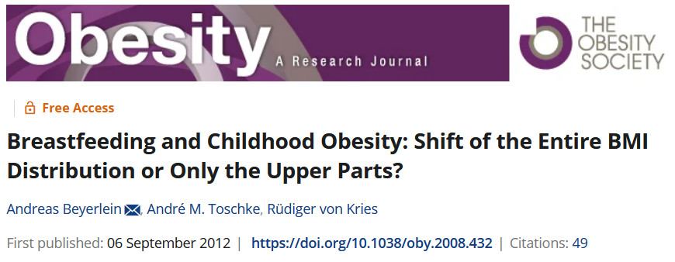
Quantile regressions at work

Slide 10
Breastfeeding and childhood obesity Beyerlein et. al. (2012)
Meta-analyses present inconsistent findings
Protective effect of breastfeeding on being overweight in later-life
Unclear association of breastfeeding with body mass index (BMI)
Hypothesis: breastfeeding affects upper percentiles of BMI
Methods:
Data on height, weight, socio-demographics from a school-entry health examination in Bavaria, Germany (N = 14,412)
Exposure: breastfed (yes/no)
Outcome: BMI
Methods: linear regression (BMI), quantile regressions (BMI), logistic regression (obesity)
Notes:
BUY-erlin

Slide 11
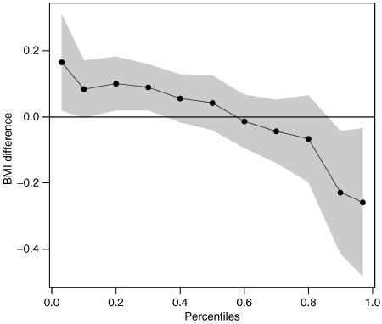
Breastfeeding reduced BMI values at high levels and increased BMI values at low levels
Notes:
Highlight crossing 0

Slide 12
Linear regression results suggest no association between breastfeeding and BMI

Slide 13
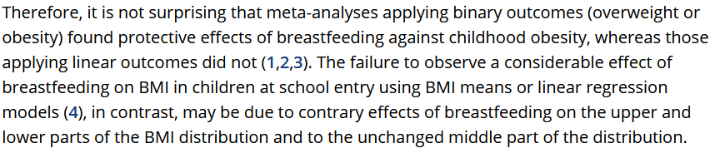
A potential resolution of the inconsistency in the meta-analysis results

Slide 14
Previewing our practical example
We will investigate the relationship between educational attainment and systolic blood pressure (SBP) in later-life
Education has a strong, inverse relationship with average SBP levels
There may be a non-linear relationship between later-life SBP and risk of coronary heart disease and stroke
Motivates the need to investigate if educational attainment affects the distribution of blood pressure

Slide 15
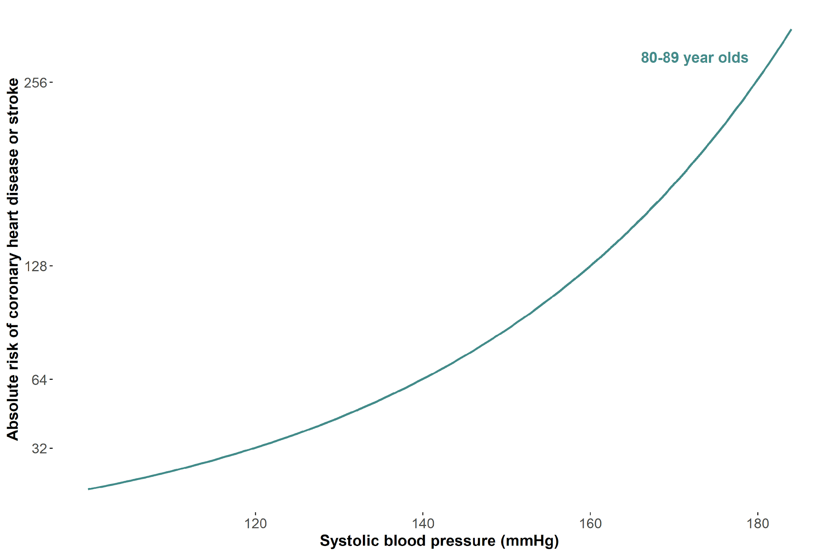
The tails matter too: case of blood pressure
This figure is a recreation of a figure from Fuchs et. al. (2020 with simulated data.
Notes:
20 mmHg change from 120-140 is an increase of 32 in absolute risk, but a 20mmHg change from 160-280 is an increase of 128 (double) of absolute risk

Slide 16
Previewing our practical example
We will use data from the US Health and Retirement Study (N = 8,875)
National sample, multi-cohort, biennially conducted longitudinal study of non-institutionalized US adults 50+ years
Exposure: Self-reported total years of schooling (5-17 years)
Outcome: First recorded SBP (2006-2018)
Covariates:
Age (linear/quadratic)
Sex (Female/Male)
Race and Ethnicity (Black/Latinx/White)
Southern birth (yes/no)
Mother’s education (5-17 years)
Father’s education (5-17 years)
SBP measurement year (2006-2018)
Notes:
CODE!!!!! Switch to R to show data and summary

Slide 17
Terminology we use interchangeably

Slide 18
Terminology we use interchangeably
Marginal and unconditional

Slide 19
Terminology we use interchangeably
Marginal and unconditional
Means and expectation

Slide 20
Terminology we use interchangeably
Marginal and unconditional
Means and expectation
Scale, spread, and variance

Slide 21
Terminology we use interchangeably
Marginal and unconditional
Means and expectation
Scale, spread, and variance Percentiles and quantiles

Slide 22
Abbreviations
Abbreviation | Full form
CDF | Cumulative Distribution Function
CEF | Conditional Expectation Function
CQF | Conditional Quantile Function
CQR | Conditional Quantile Regression
DGP | Data Generating Process
IF | Influence function
OLS | Ordinary Least Squares
RIF | Recentered Influence Function
SBP | Systolic Blood Pressure
UQR | Unconditional Quantile Regression

Slide 23
Outline of the workshop
Linear regression, conditional quantile regression, and why we care about quantile regression
Unconditional quantile regression
Standard errors
Visualization
Extensions
Conclusion
Notes:
Intro – Jilly, 1 – Amanda; 2 – Jilly; 3 – Jilly; 4 – Amanda; 5 – Amanda; 6 – Amanda

Slide 24
Key takeaways from this workshop
Why investigating the effect of an exposure across the entire outcome distribution is substantively important
How to model associations between an exposure and the conditional or unconditional outcome distribution
How to appropriately adjust standard errors, and subsequently confidence intervals
How to visualize quantile regression estimates, and potential counterfactual distributions associated with those estimates

Slide 25
Linear regression and Conditional quantile regressions (CQR)
Notes:
Amanda

Slide 26
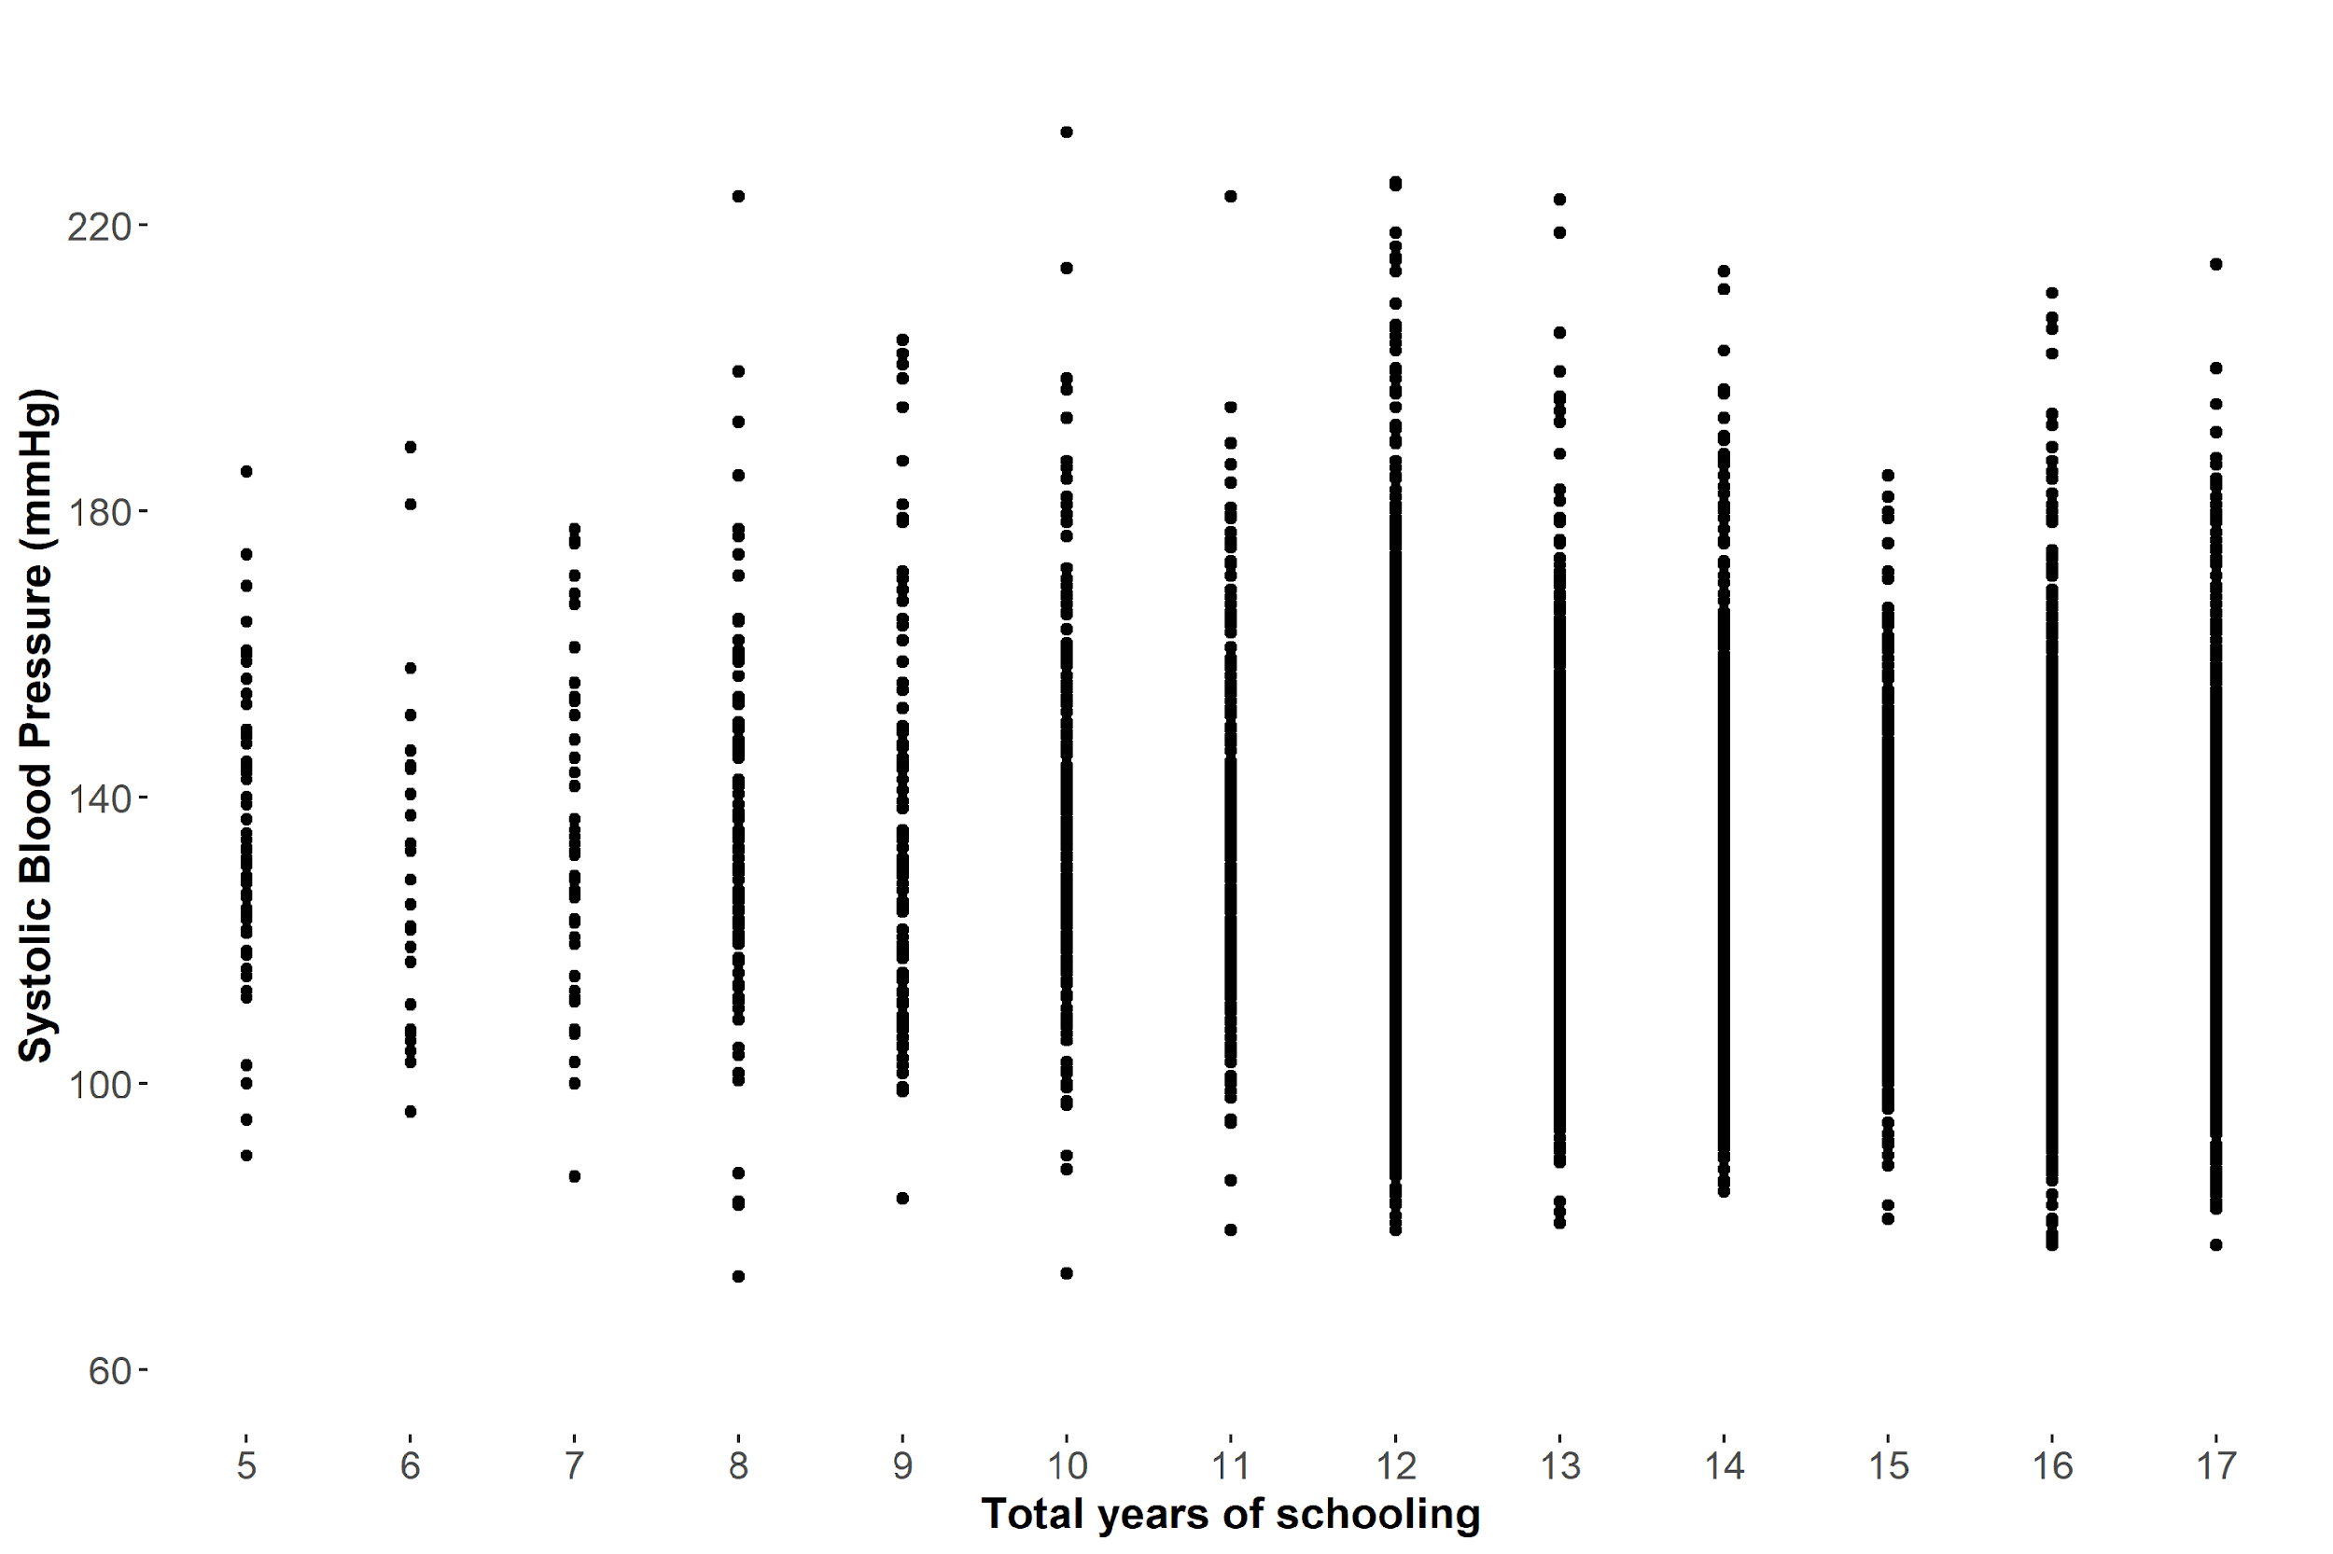
Objective: Quantify the association of education with SBP

Slide 27
Calculate mean SBP by education level (i.e., the conditional expectation)
Notes:
Say you were given this dataset and there’s a study participant that you don’t have SBP data for, but you do know how many years of schooling they had. What would you guess their SBP would be?
One way to summarize the relationship between education and SBP would be just to calculate the mean value of SBP at each value of schlyrs – but this gives us a lot of numbers. What we really want is a way to summarize the data with a single line

Slide 28
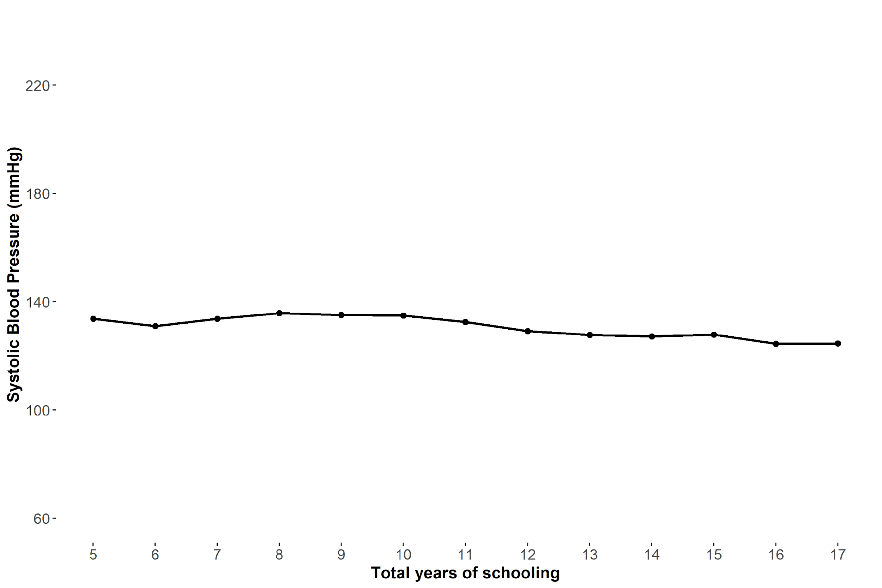
Conditional expectation function (CEF) links the conditional means
Notes:
CEF = E[Y|X]
In this case, we only have points at whole numbers of schooling. This line would allow us to estimate what a participant’s SBP would be if they have, say, 7.5 years of education

Slide 29
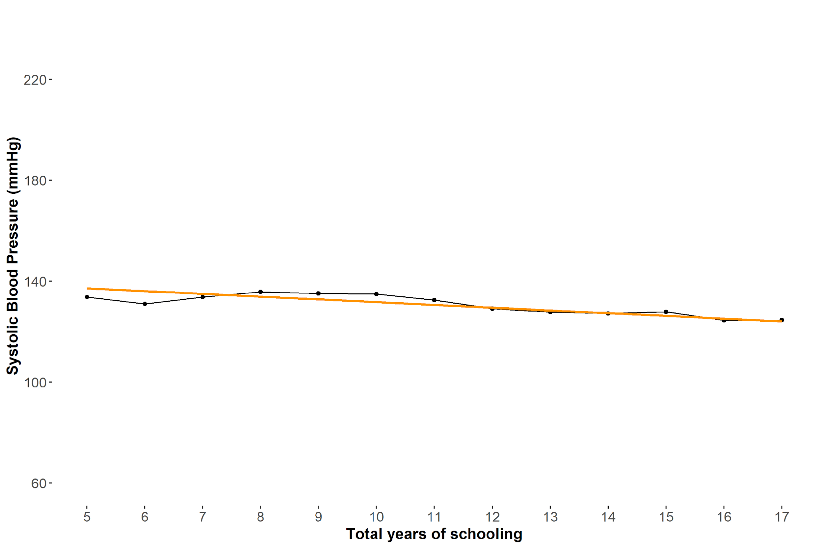
Linear regression line ≈ CEF
Notes:
Linear regression is the best approximation to the CEF – best-fit line through the CEF and is much simpler

Slide 30

$$E\left[SBP | schlyrs\right]=β_{0}+β_{1}schlyrs_{i}$$
Notes:
Talk about how the CEF is represented on left-hand side, and slope of the line is defined by beta1

Slide 31
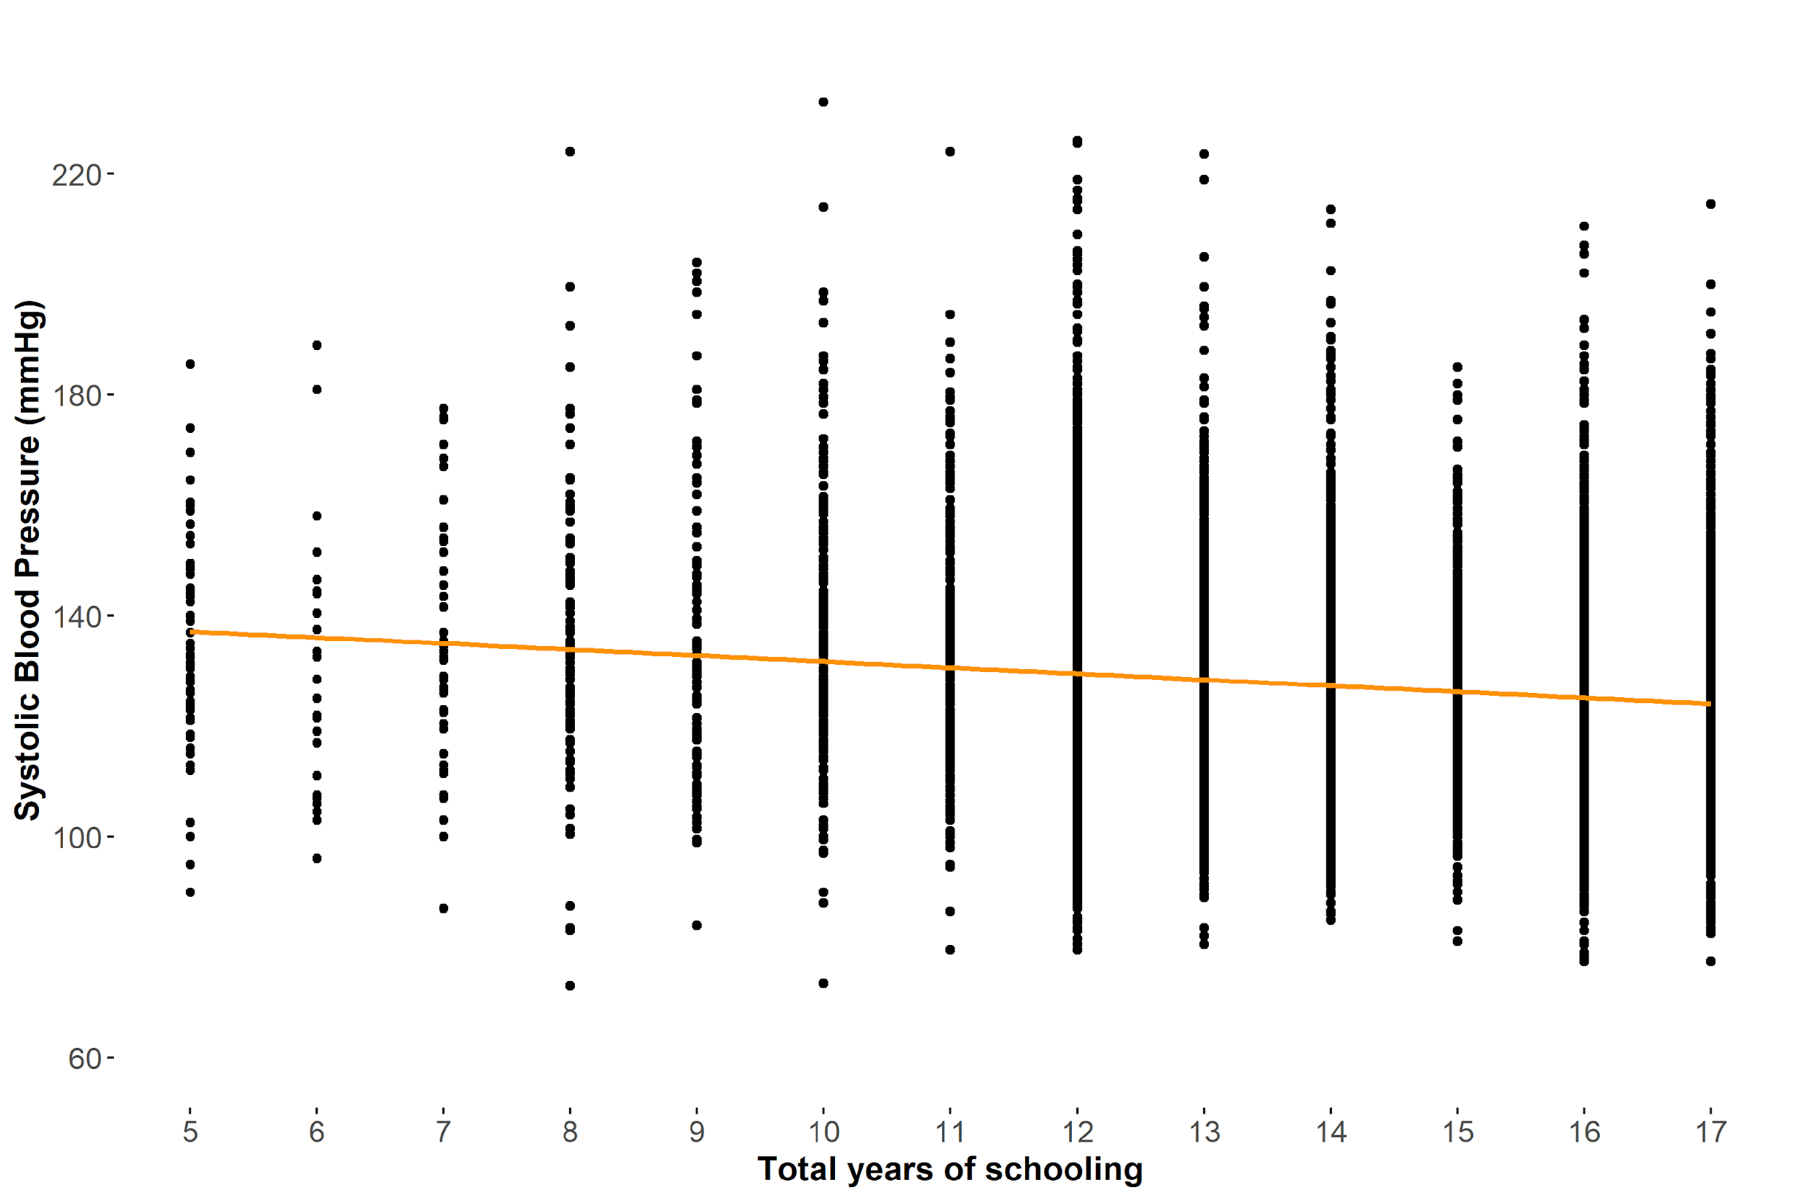
Let’s try this in R lm(sbp ~ schlyrs)
Notes:
Switch to R here (show unadjusted then adjusted

Slide 32
Poll Time!

Slide 33
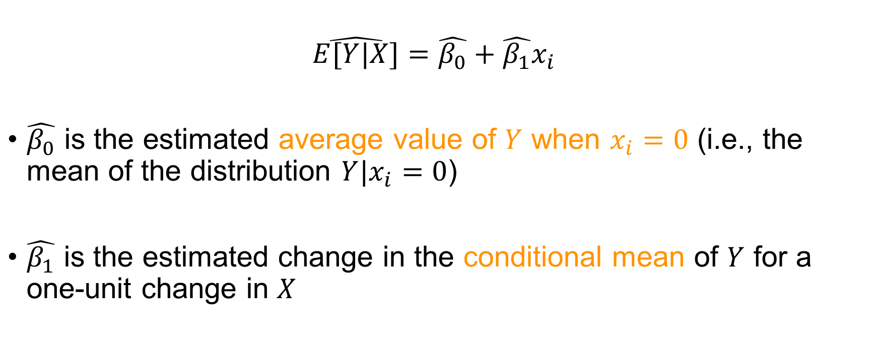
Interpreting coefficients of a simple linear regression
$$\hat{E[Y|X]}=\hat{β_{0}}+\hat{β_{1}}x_{i}$$
$\hat{β_{0}}$ is the estimated average value of $Y$ when $x_{i}=0$ (i.e., the mean of the distribution $Y|x_{i}=0$)
$\hat{β_{1}}$ is the estimated change in the conditional mean of $Y$ for a one-unit change in $X$
Notes:
Note the hats, which tell us that all of these parameters are referring to the sample population and not the total population that we’re hoping we can extrapolate to

Slide 34
Since it is a model of the conditional expectation function, linear regression estimates how the mean of the outcome changes as we change the exposure by one unit

Slide 35
What if we want to calculate estimates for how other parts of the distribution change as we change the exposure by one unit?

Slide 36
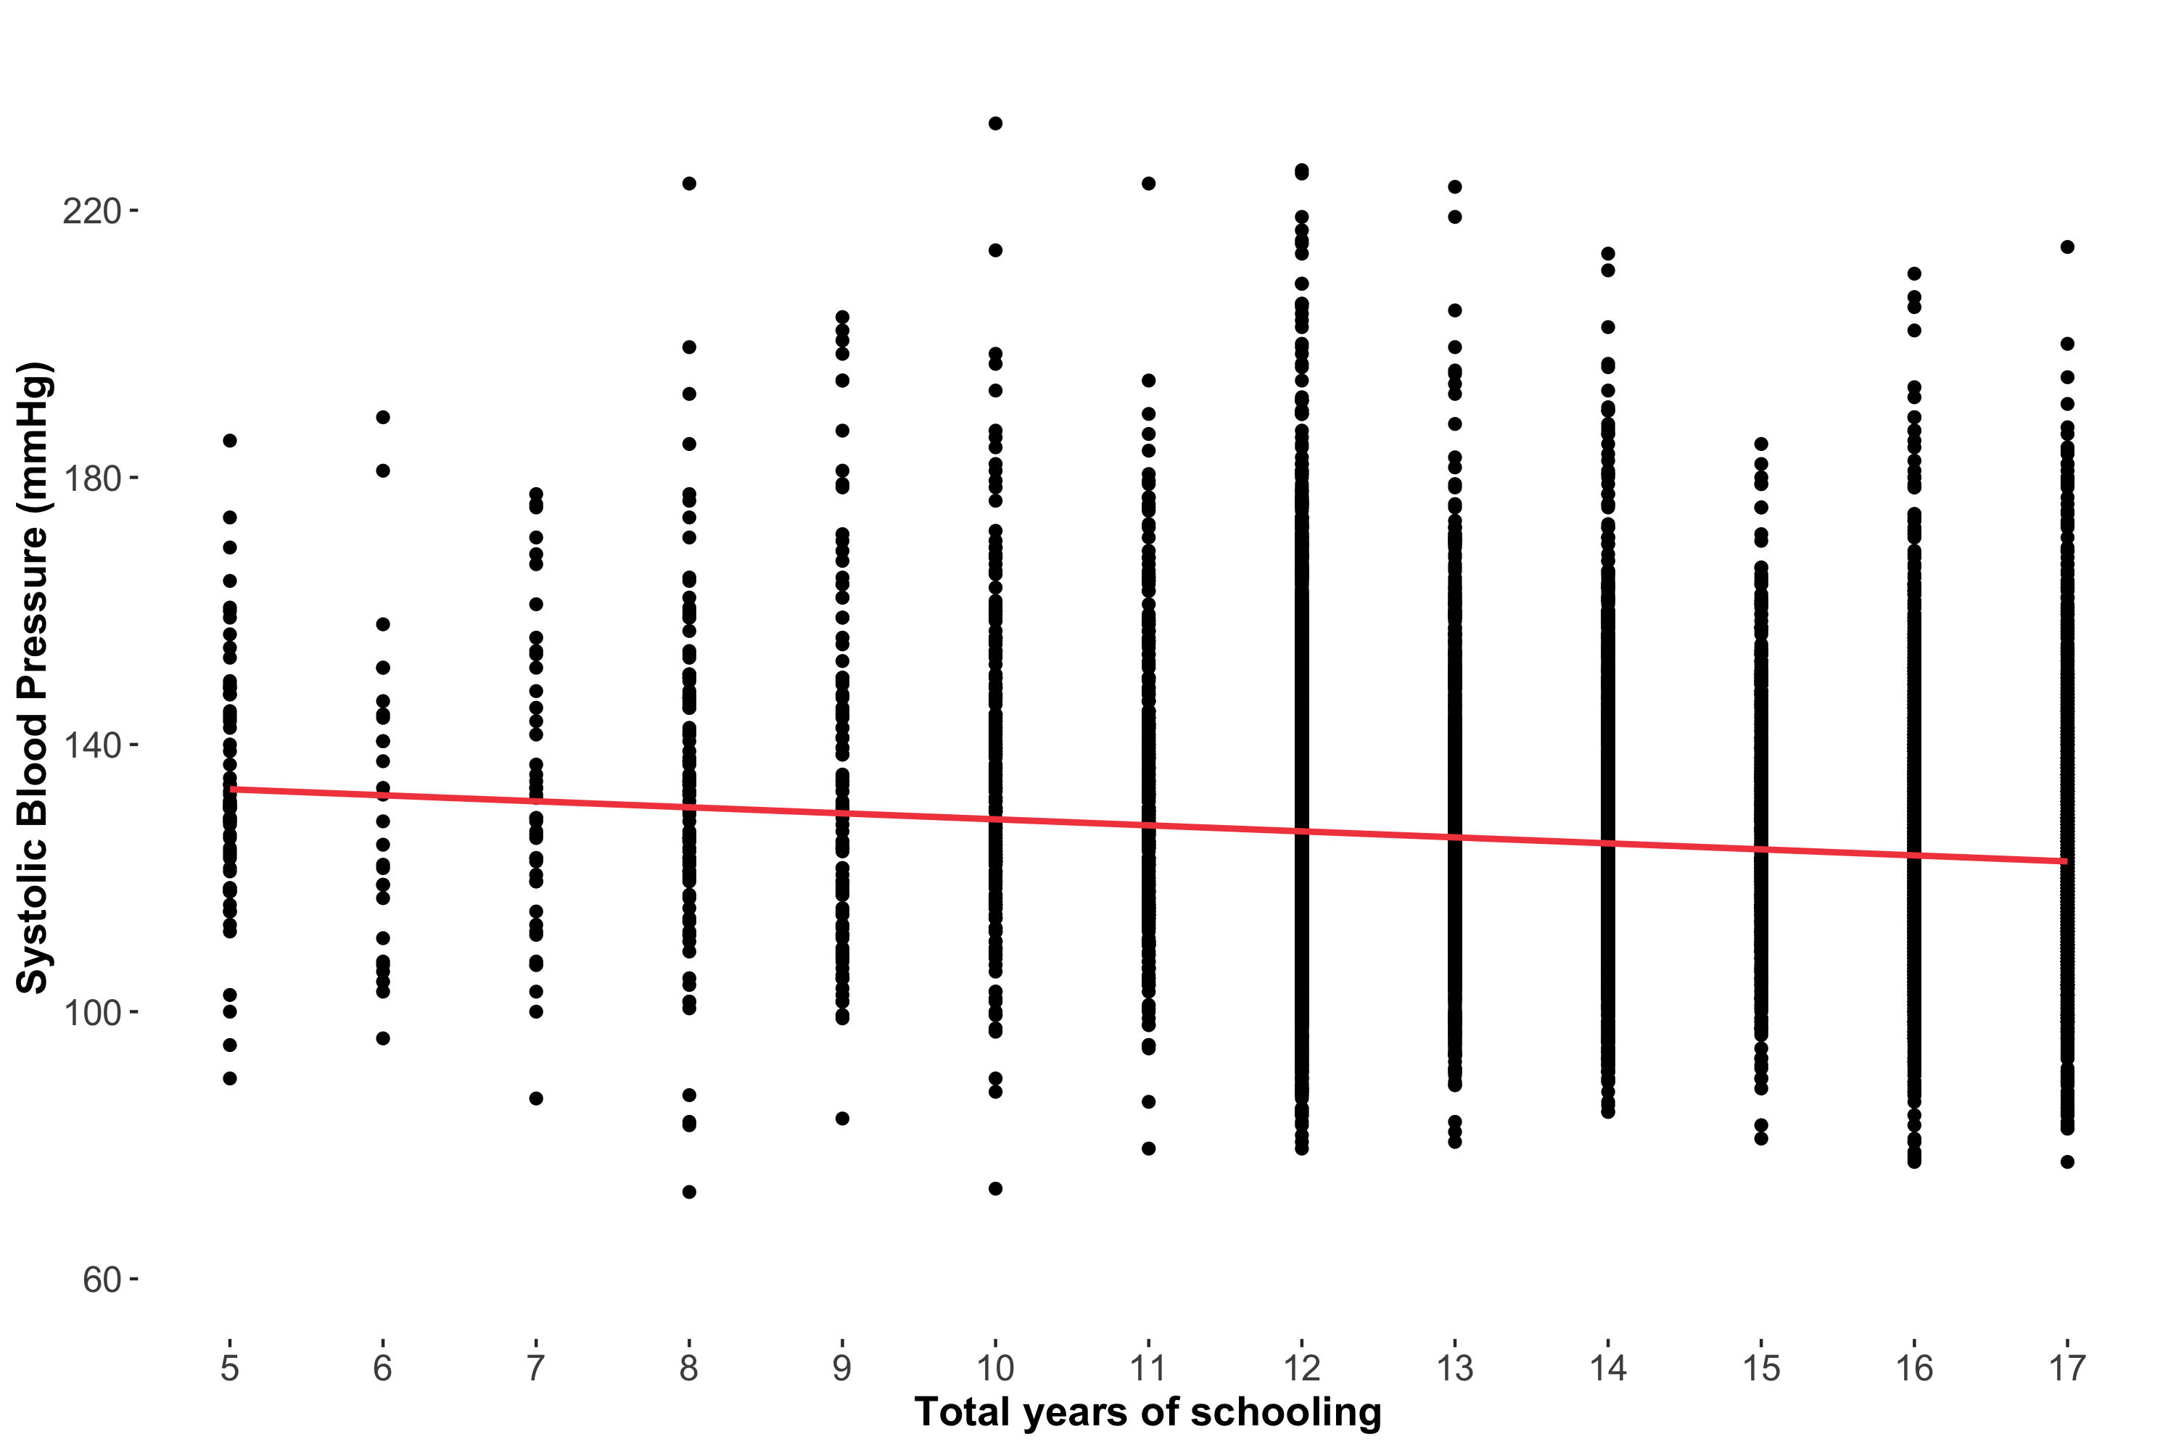
Notes:
Switch to R here (show CQR adjusted)
Quantreg package, rq()

Slide 37
Poll Time!

Slide 38
Interpreting CQR results follows the same framework as interpreting linear regression results, except estimates are now about how the quantile of interest of the outcome changes (as opposed to the mean)
Notes:
Congratulations, you fit your first CQR!

Slide 39
Imagine that we calculated the conditional 25th quantile instead

Slide 40
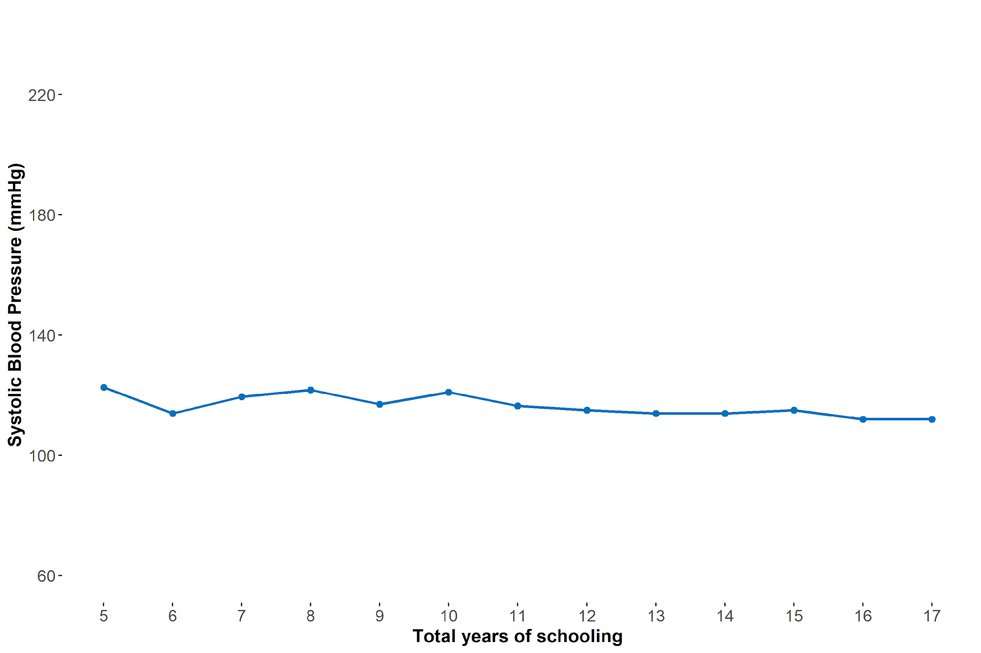
Conditional quantile function (CQF) at the 25th quantile

Slide 41
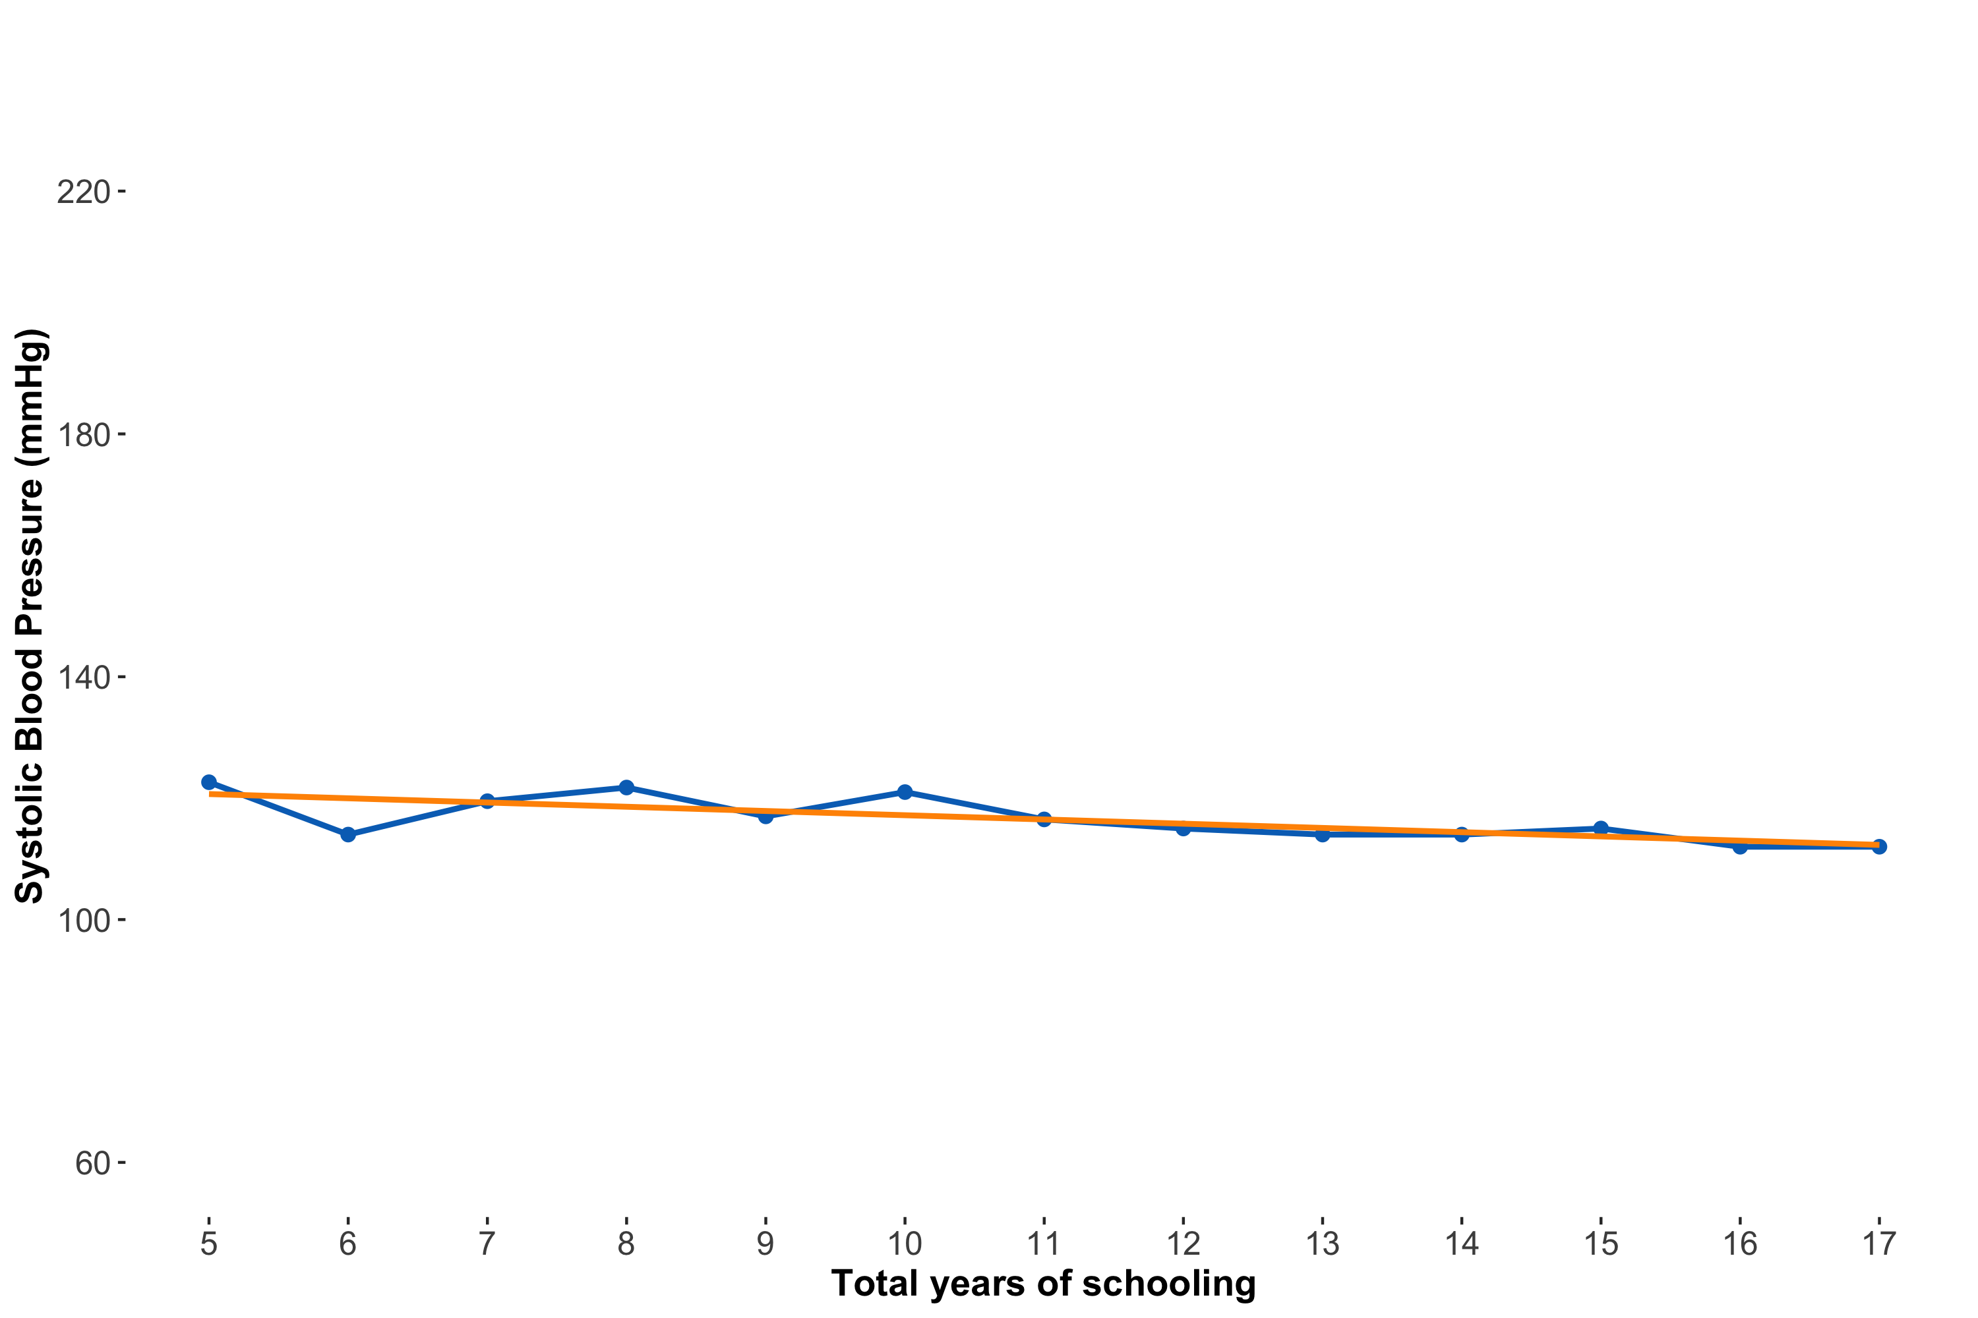
Conditional quantile regression line ≈ CQF

Slide 42

$$Q_{τ}(SBP|schlyrs)=α_{0, τ}+α_{1, τ}schlyrs_{i}$$
Notes:
What are the similarities/differences you see between this equation and the linear regression equation?
Diff - adding taus – with CQR we want to be specific about what our quantile of interest is. We don’t need to do this with linear regression because there’s no ambiguity about what we’re estimating – always the mean

Slide 43

$$Q_{0.25}(SBP|schlyrs)=α_{0, 0.25}+α_{1, 0.25}schlyrs_{i}$$

Slide 44
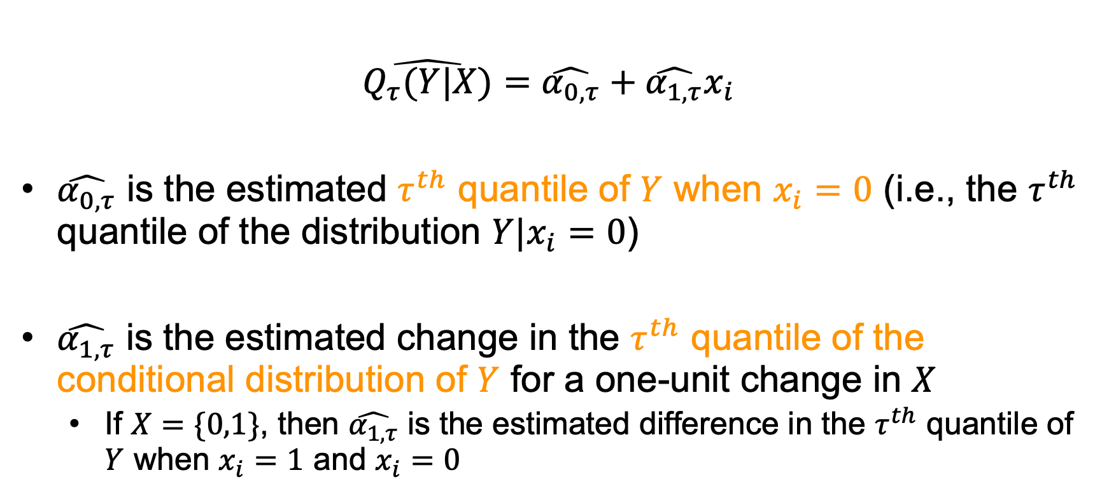
Interpreting coefficients of a univariate conditional quantile regression line
$$\hat{Q_{τ}(Y|X)}=\hat{α_{0,τ}}+\hat{α_{1,τ}}x_{i}$$
$\hat{α_{0,τ}}$ is the estimated $τ^{th}$ quantile of $Y$ when $x_{i}=0$ (i.e., the $τ^{th}$ quantile of the distribution $Y|x_{i}=0$)
$\hat{α_{1,τ}}$ is the estimated change in the $τ^{th}$ quantile of the conditional distribution of $Y$ for a one-unit change in $X$
If $X=\{0,1\}$, then $\hat{α_{1,τ}}$ is the estimated difference in the $τ^{th}$ quantile of $Y$ when $x_{i}=1$ and $x_{i}=0$
Notes:
If X= {0,1} – if you have a binary predictor variable, there’s a different interpretation: different between the outcome between the two states. For example, if we had another variable for whether a respondent attended a public school, then alpha 1 tau would be the estimated different in Y at the tauth quantile for those who attended public school vs. those who didn’t

Slide 45
Just as linear regression models the conditional expectation function, conditional quantile regression models the conditional quantile function

Slide 46
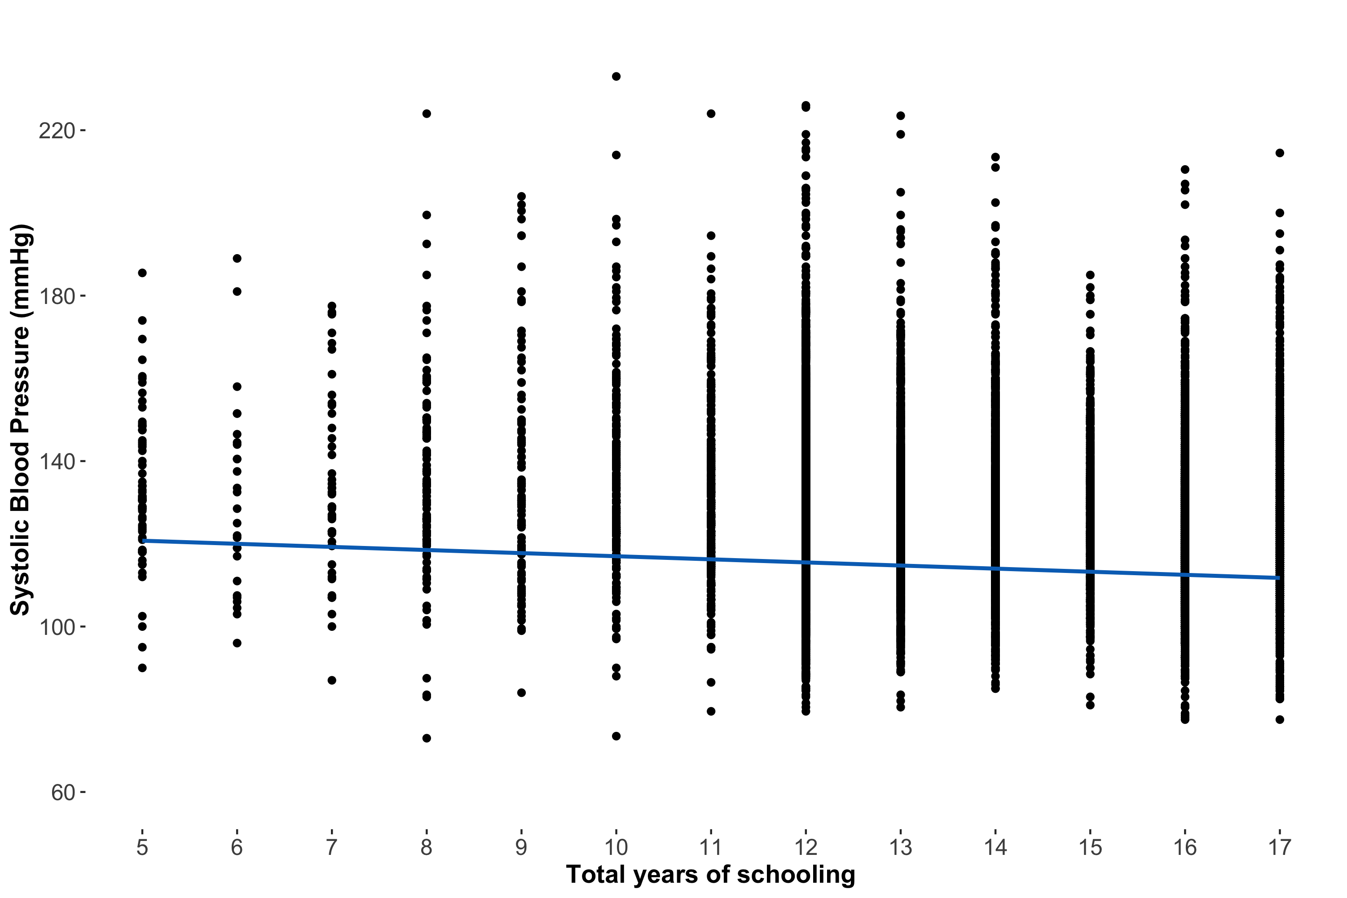
Notes:
Switch to R here (q25 adjusted model)

Slide 47
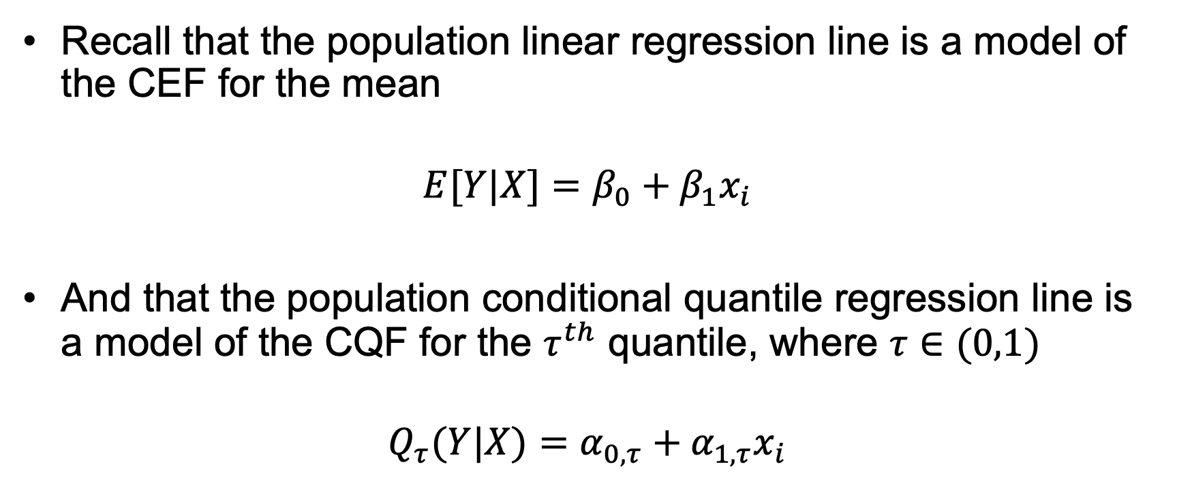
Regression lines ≈ Conditional functions
Recall that the population linear regression line is a model of the CEF for the mean
$$E[Y|X]=β_{0}+β_{1}x_{i}$$
And that the population conditional quantile regression line is a model of the CQF for the $τ^{th}$ quantile, where $τ∈(0,1)$
$$Q_{τ}(Y|X)=α_{0,τ}+α_{1,τ}x_{i}$$

Slide 48
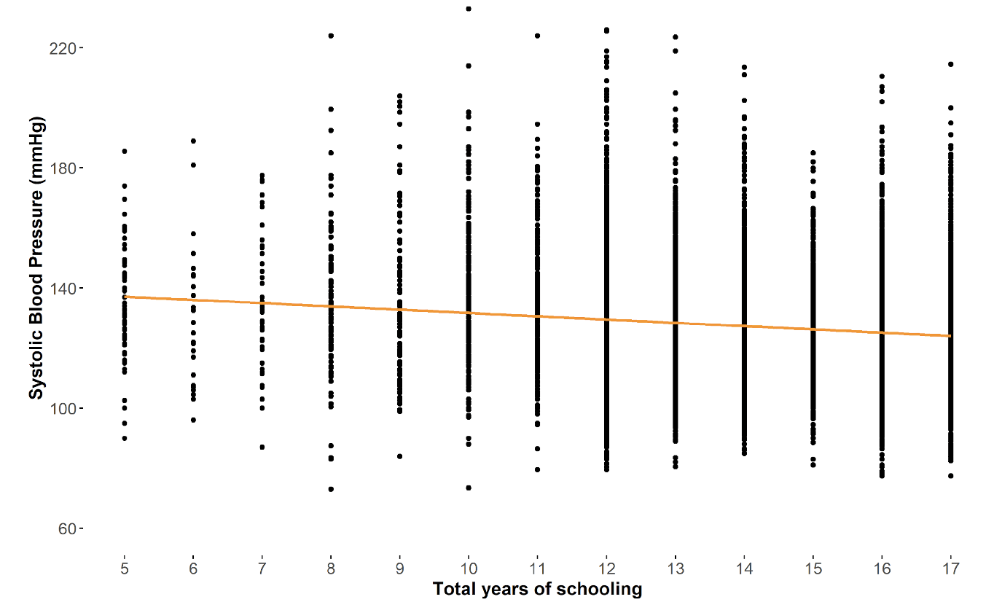
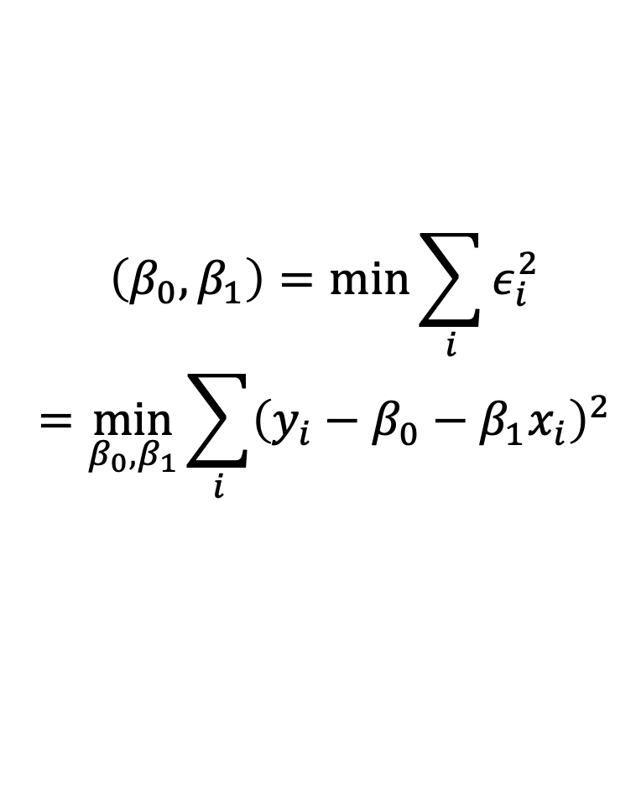
Coefficients of the population linear regression line
We can calculate the coefficients of the population linear regression line by minimizing the sum of squared errors
$$\left(β_{0},β_{1}\right)=\min_{}{\sum_{i}{ε_{i}^{2}}}$$
$$=\min_{β_{0},β_{1}}{\sum_{i}{{\left(y_{i}−β_{0}−β_{1}x_{i}\right)}^{2}}}$$
Notes:
Note that here we’re referring to the larger population that we’re hoping to extrapolate to: no hats
Yi is each respondent’s observed value
Want to see how far away each point is from the regression line, so subtract out the parameters of the regression like, b0 and b1
Square because we want all the numbers to be positive b/c we’re minimizing

Slide 49
Estimating linear regression coefficients in our sample
There are several ways to estimate coefficients of the sample linear regression
Ordinary Least Squares
Moment estimator
Maximum likelihood estimator
Notes:
Incomplete list!

Slide 50
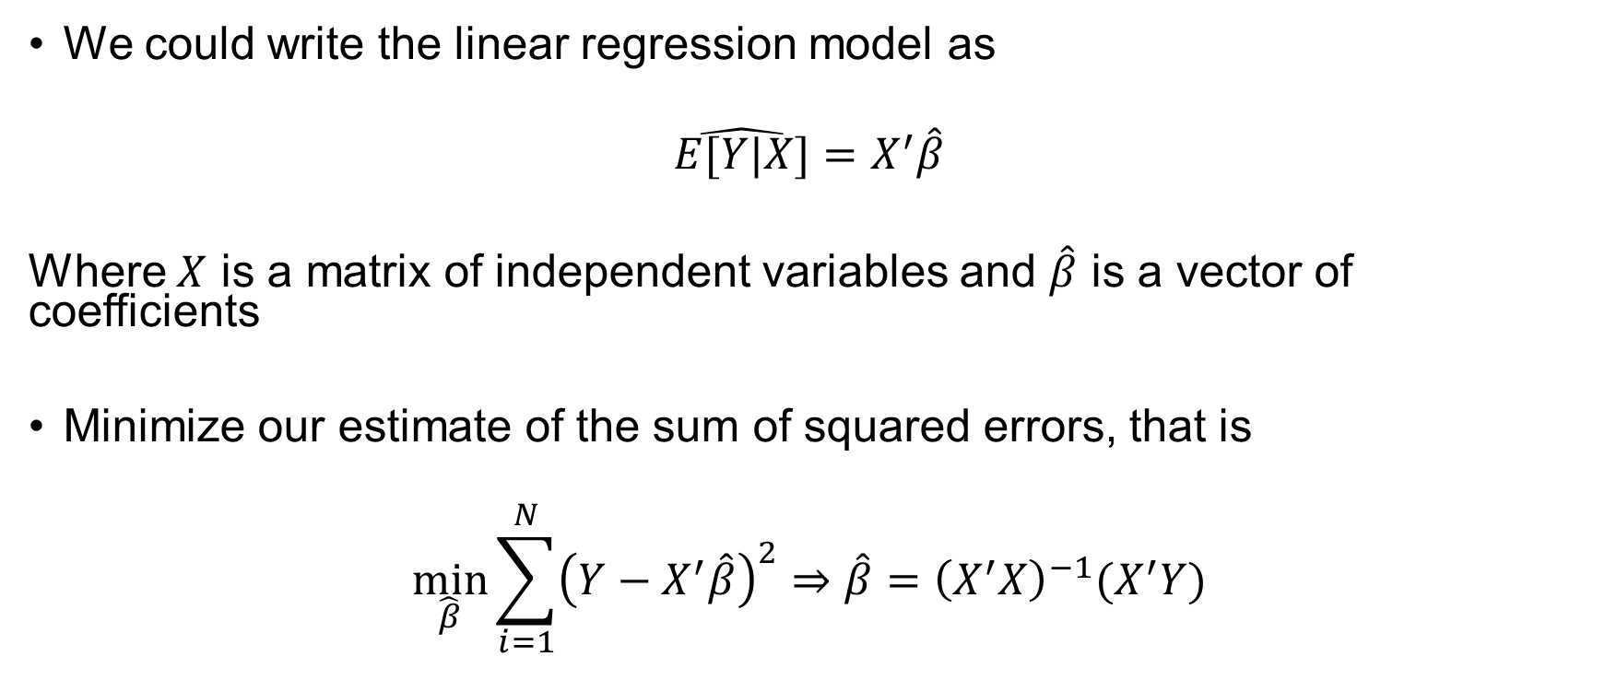
Ordinary Least Squares (OLS)
We could write the linear regression model as
$$\hat{E[Y|X]}=X^{′}\hat{β}$$
Where $X$ is a matrix of independent variables and $\hat{β}$ is a vector of coefficients
Minimize our estimate of the sum of squared errors, that is
$$\min_{\hat{β}}{\sum_{i=1}^{N}{{\left(Y−X^{′}\hat{β}\right)}^{2}}}⇒\hat{β}={\left(X^{′}X\right)}^{−1}(X^{′}Y)$$

Slide 51
How do we estimate coefficients of a conditional quantile regression?

Slide 52


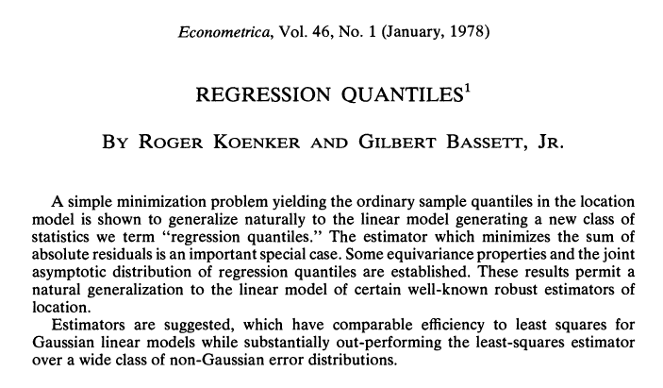
Koenker and Bassett (1978). Regression Quantiles. Econometrica 46(1): 33-50
Roger Koenker. Source: link
Gilbert Bassett, Jr. Source: link
Notes:
Over 17k citations
2 econometricians – not surprising they would develop this since a lot of economists study what happens at the tails of the distributions & skewed distributions – e.g., income

Slide 53
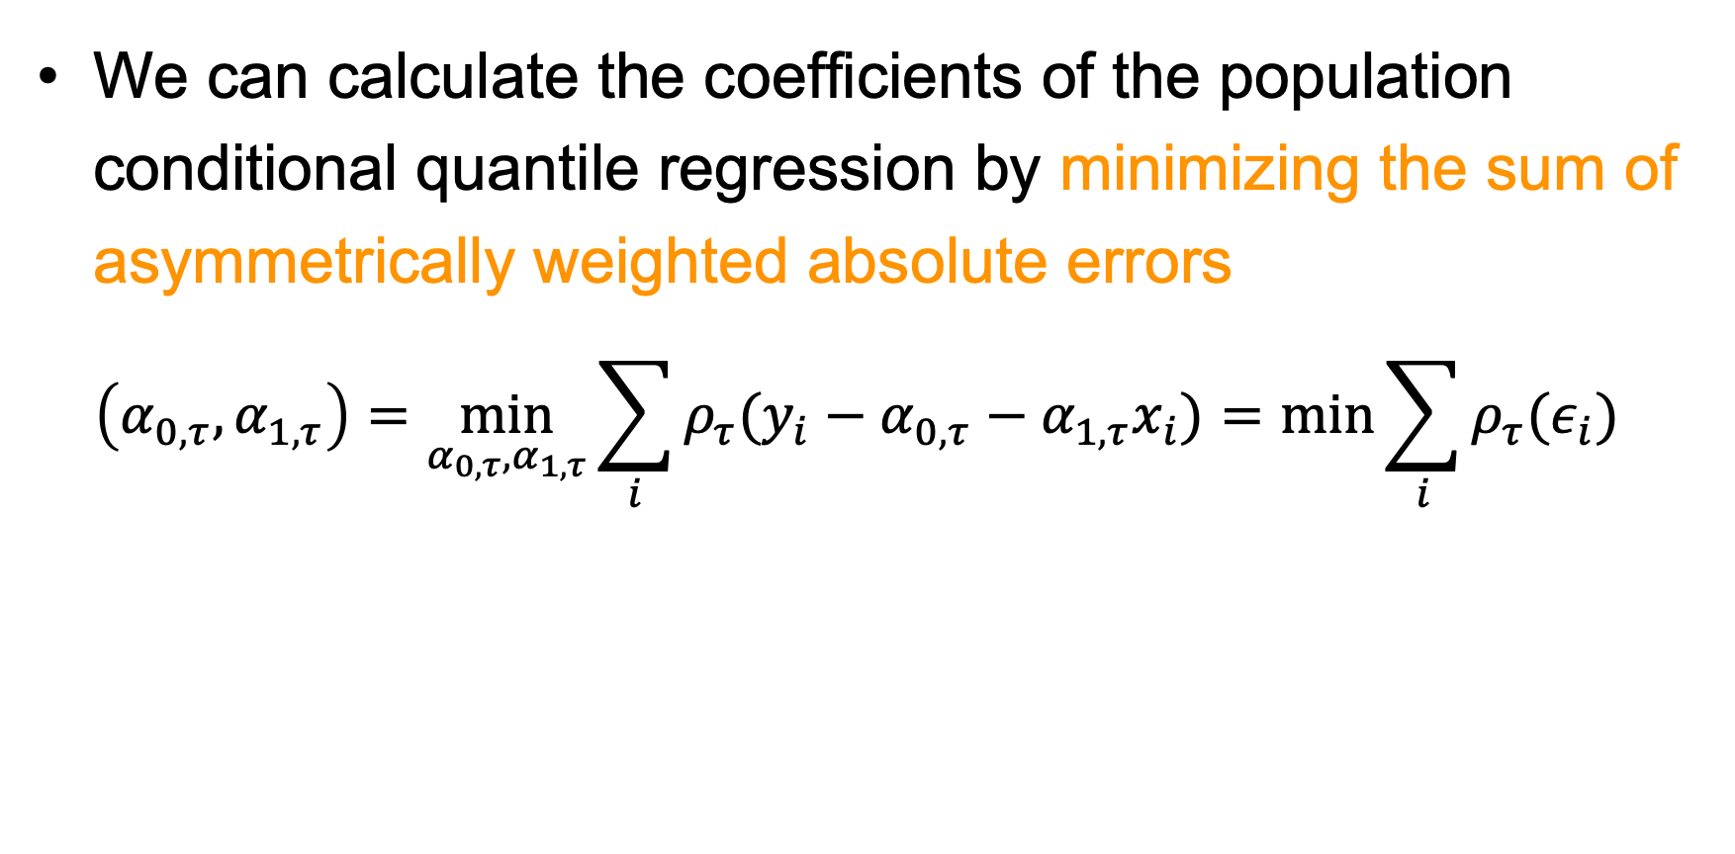
Coefficients of the population conditional quantile regression line
We can calculate the coefficients of the population conditional quantile regression by minimizing the sum of asymmetrically weighted absolute errors
$$\left(α_{0,τ},α_{1,τ}\right)=\min_{α_{0,τ},α_{1,τ}}{\sum_{i}{ρ_{τ}(y_{i}−α_{0,τ}−α_{1,τ}x_{i})=\min_{}{\sum_{i}{ρ_{τ}(ε_{i})}}}}$$
Notes:
Differences?

Slide 54
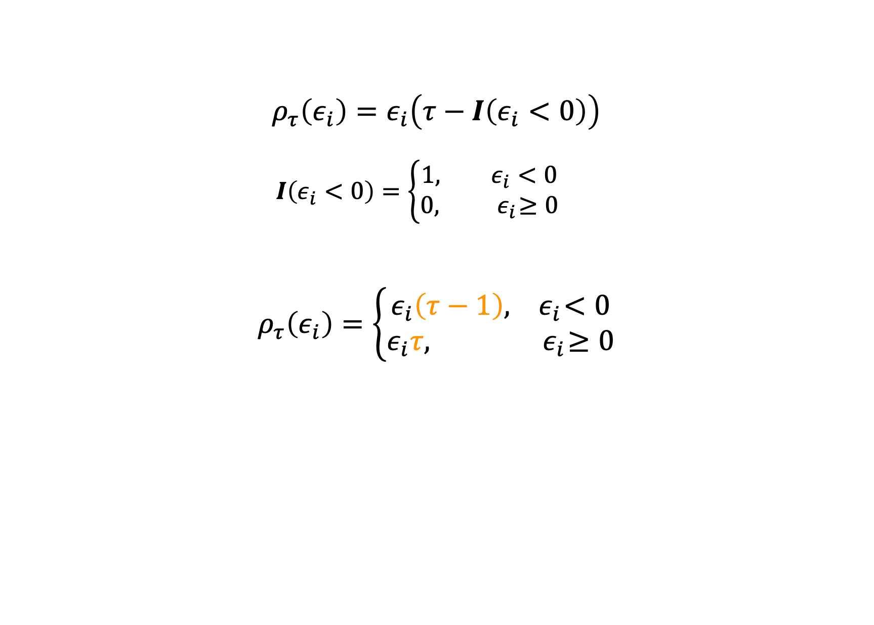
The rho function
$$ρ_{τ}\left(ε_{i}\right)=ε_{i}\left(τ−I\left(ε_{i}<0\right)\right)$$
$$I\left(ε_{i}<0\right)=\left\{\begin{aligned}1, ε_{i}<0 \\ &0,{ ε}_{i}≥0\end{aligned}\right.$$
$$ρ_{τ}\left(ε_{i}\right)=\left\{\begin{aligned}ε_{i}\left(τ−1\right),{ ε}_{i}<0 \\ &ε_{i}τ,{ ε}_{i}≥0\end{aligned}\right.$$
$$=\left(1−τ\right)\left|ε_{i}\right|I\left(ε_{i}<0\right)+τ\left|ε_{i}\right|I\left(ε_{i}≥0\right)$$
Notes:
Top line: rho tau is a function of the error term where the error term will be multiplied by one of 2 values depending on the indicator function I
Rho of error term = function
Bottom line – if you want to write all out you can, this is what it’s looks like as one equation – one side of the equation will drop out depending on whether error is above or below 0

Slide 55
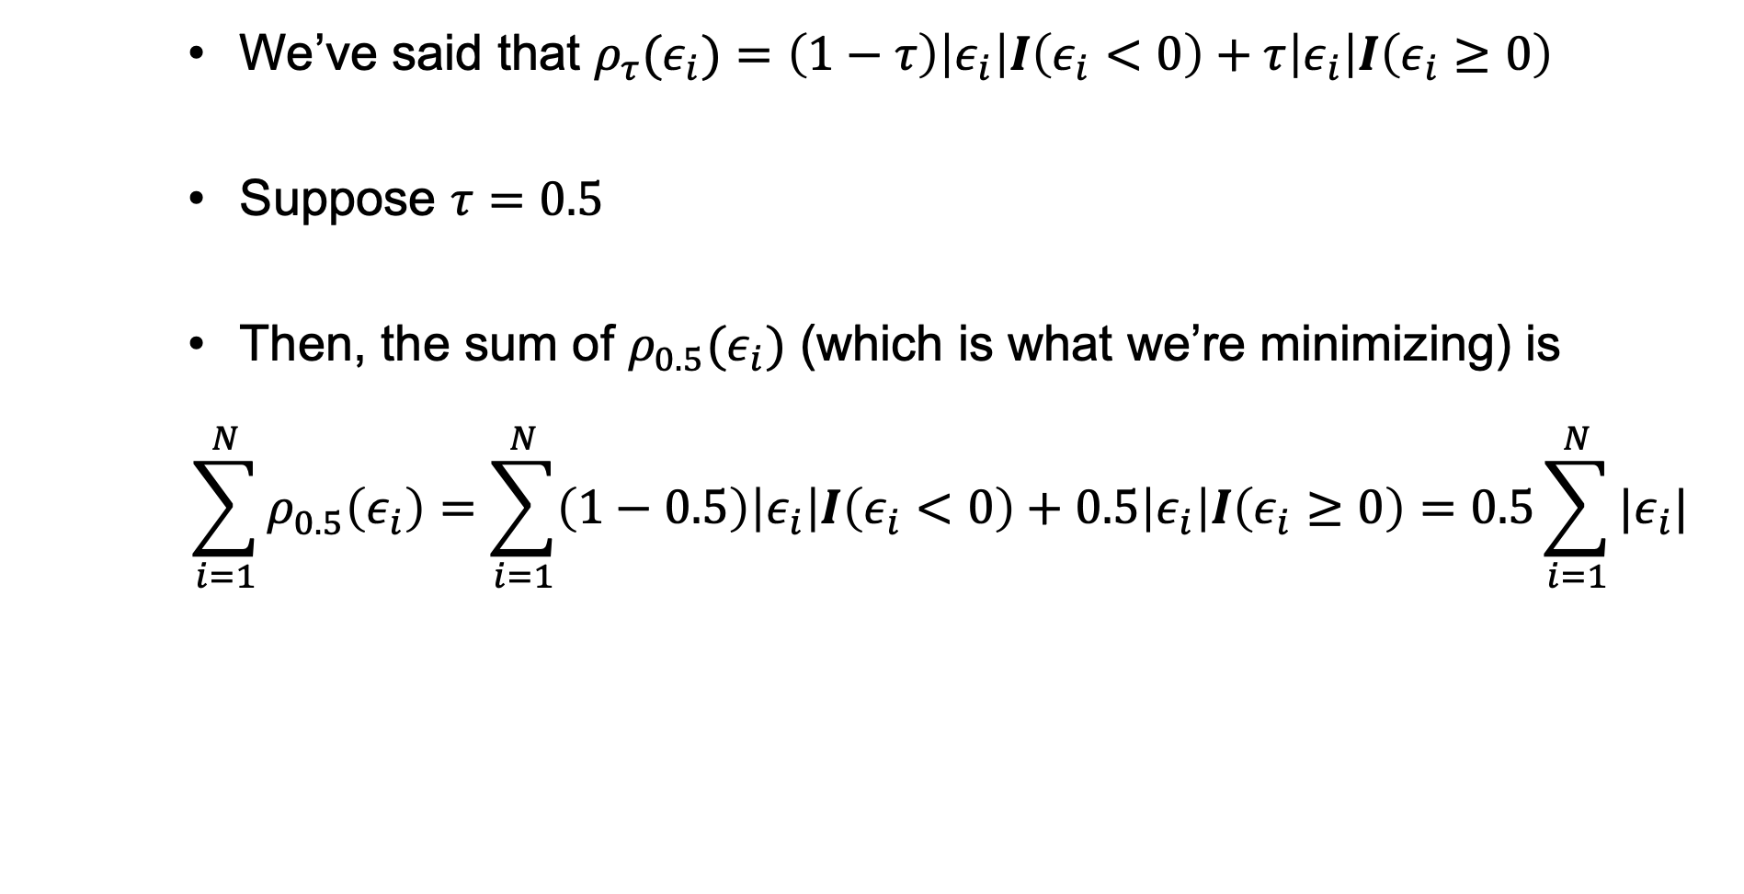
Contextualizing rho (the special case)
We’ve said that $ρ_{τ}(ε_{i})=\left(1−τ\right)\left|ε_{i}\right|I\left(ε_{i}<0\right)+τ\left|ε_{i}\right|I\left(ε_{i}≥0\right)$
Suppose $τ=0.5$
Then, the sum of $ρ_{0.5}(ε_{i})$ (which is what we’re minimizing) is
$$\sum_{i=1}^{N}{ρ_{0.5}\left(ε_{i}\right)}=\sum_{i=1}^{N}{\left(1−0.5\right)\left|ε_{i}\right|I\left(ε_{i}<0\right)+0.5\left|ε_{i}\right|I\left(ε_{i}≥0\right)}=0.5\sum_{i=1}^{N}{|ε_{i}|}$$
Notes:
This is how we calculate the coefficients of q0.5

Slide 56
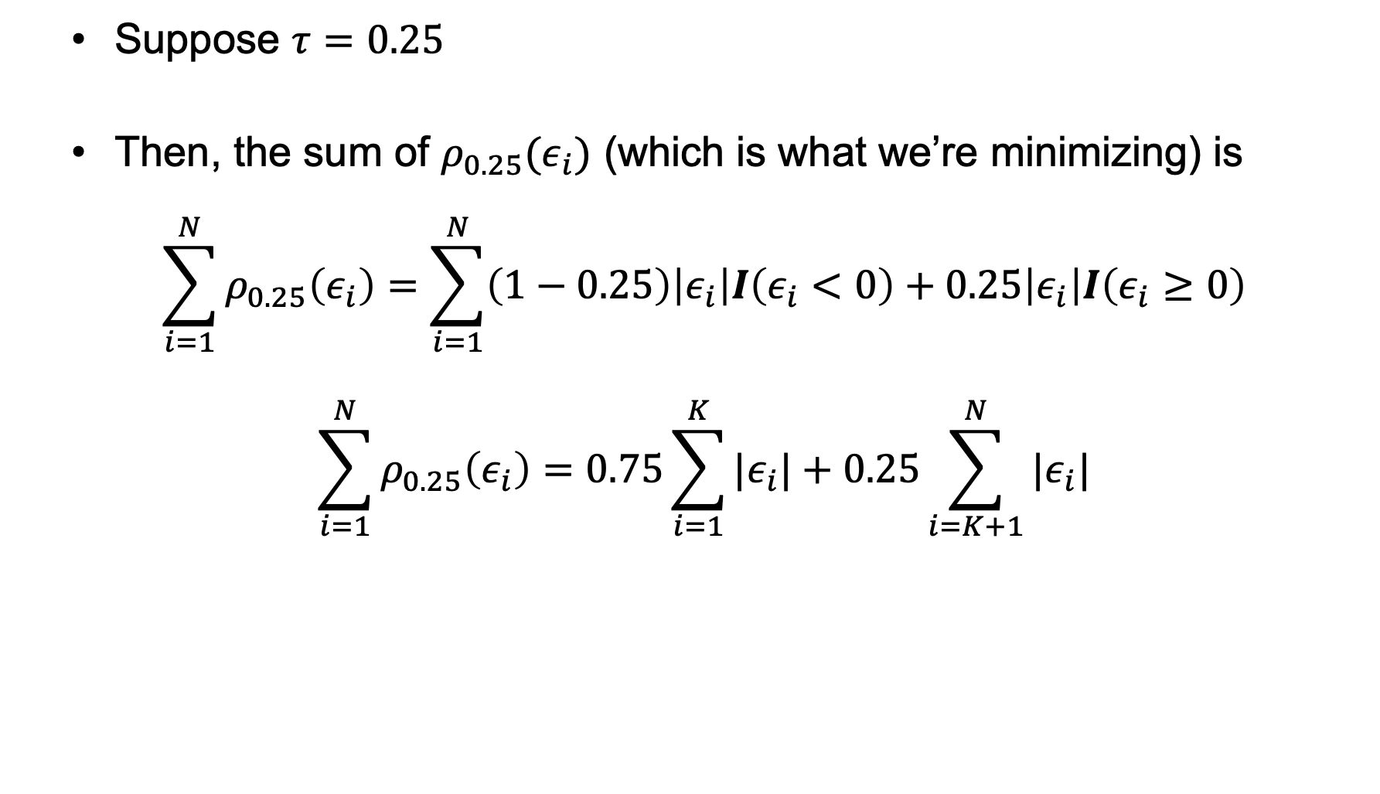
Contextualizing rho (all other cases)
Suppose $τ=0.25$
Then, the sum of $ρ_{0.25}(ε_{i})$ (which is what we’re minimizing) is
$$\sum_{i=1}^{N}{ρ_{0.25}\left(ε_{i}\right)}=\sum_{i=1}^{N}{\left(1−0.25\right)\left|ε_{i}\right|I\left(ε_{i}<0\right)+0.25\left|ε_{i}\right|I\left(ε_{i}≥0\right)}$$
$$\sum_{i=1}^{N}{ρ_{0.25}\left(ε_{i}\right)}=0.75\sum_{i=1}^{K}{|ε_{i}|}+0.25\sum_{i=K+1}^{N}{|ε_{i}|}$$
Notes:
End up with 0.75 * summation of the absolute values of the error terms for those with errors <0, and 0.25 * summation of the absolute values of the error terms for those with errors >=0
K is indicating all of the people whose errors were <0, k+1 to N is indicating all of the people whose errors were >=0
To clarify, this is what the equation looks like for the median as well, but the multiplier is 0.5 for both error indicators, which is why it simplifies to the sum of all individuals in the sample
You’ll never need to do this by hand, but just to show you how the coefficients are calculated behind the scenes

Slide 57
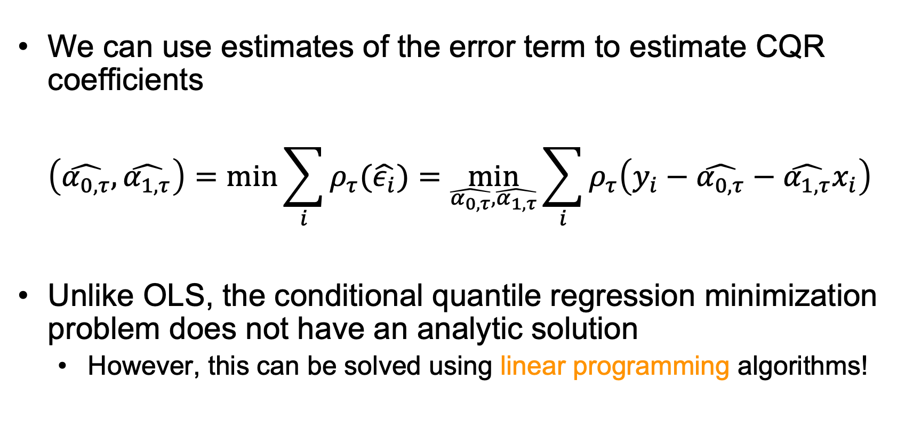
Estimating conditional quantile regression coefficients in our sample
We can use estimates of the error term to estimate CQR coefficients
$$\left(\hat{α_{0,τ}},\hat{α_{1,τ}}\right)=\min_{}{\sum_{i}{ρ_{τ}(\hat{ε_{i}})}}=\min_{\hat{α_{0,τ}},\hat{α_{1,τ}}}{\sum_{i}{ρ_{τ}\left(y_{i}−\hat{α_{0,τ}}−\hat{α_{1,τ}}x_{i}\right)}}$$
Unlike OLS, the conditional quantile regression minimization problem does not have an analytic solution
However, this can be solved using linear programming algorithms!

Slide 58
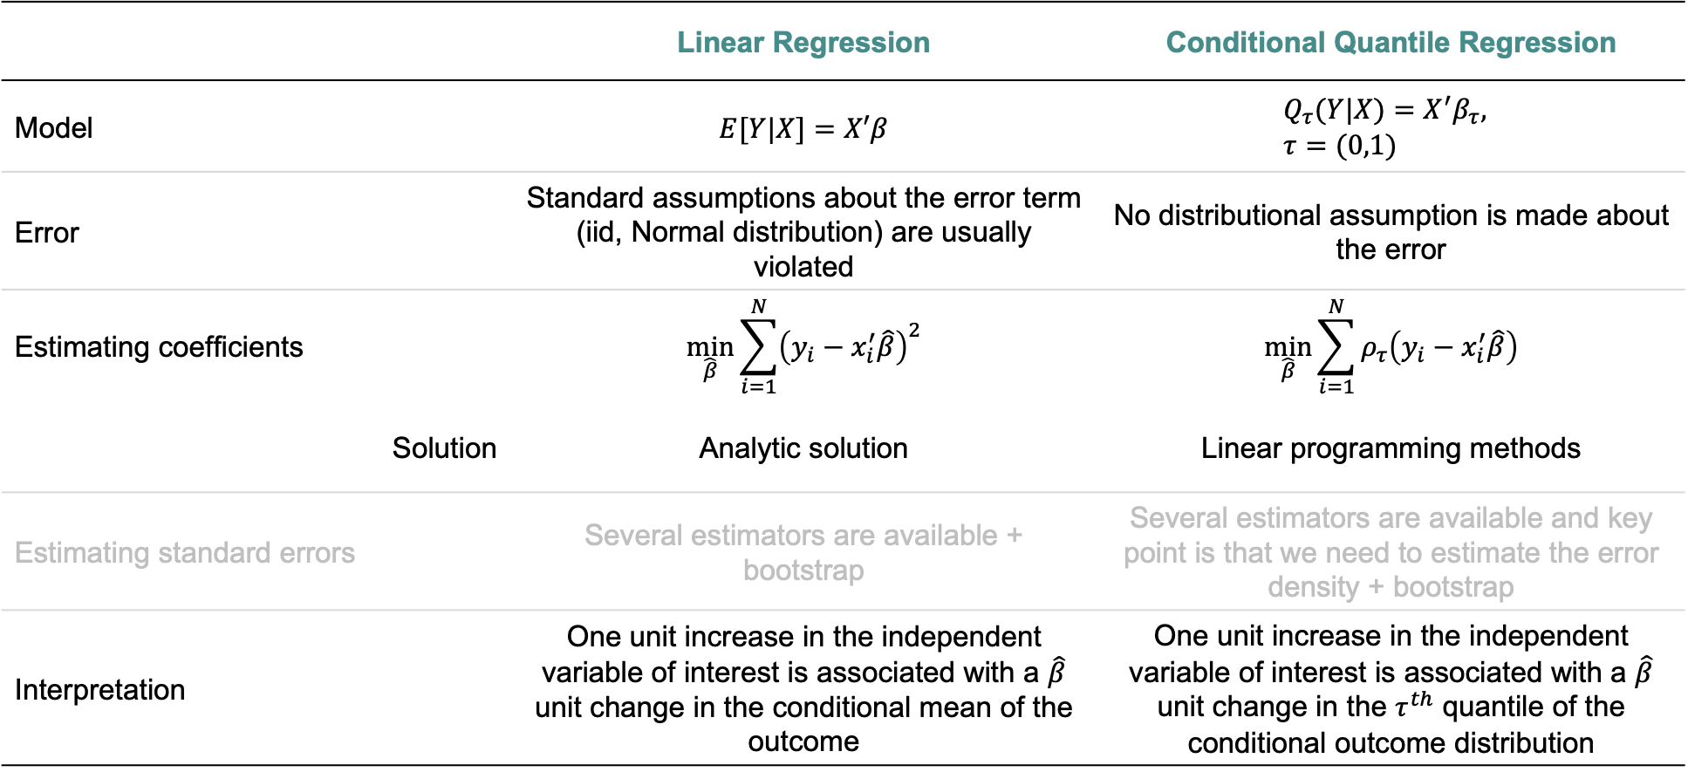
 | Linear Regression | Conditional Quantile Regression
Model | $$E[Y|X]=X′β$$ | $$Q_{τ}(Y|X)=X^{′}β_{τ}, \\ τ=(0,1)$$
Error | Standard assumptions about the error term (iid, Normal distribution) are usually violated | No distributional assumption is made about the error
Estimating coefficients | $$\min_{\hat{β}}{\sum_{i=1}^{N}{{\left(y_{i}−x_{i}^{′}\hat{β}\right)}^{2}}}$$ | $$\min_{\hat{β}}{\sum_{i=1}^{N}{ρ_{τ}\left(y_{i}−x_{i}^{′}\hat{β}\right)}}$$
Solution | Analytic solution | Linear programming methods
Estimating standard errors | Several estimators are available + bootstrap | Several estimators are available and key point is that we need to estimate the error density + bootstrap
Interpretation | One unit increase in the independent variable of interest is associated with a $\hat{β}$ unit change in the conditional mean of the outcome | One unit increase in the independent variable of interest is associated with a $\hat{β}$ unit change in the $τ^{th}$ quantile of the conditional outcome distribution
Notes:
Iid = independent and identically distributed (independent from each other, identically distributed = homoskedasticity)
We’ll talk more about this when we talk about standard errors – more to come!

Slide 59
Why is the mean model one of the most common choices of method for analyses?
Notes:
So, if it is that easy to evaluate the relationship at other parts of the distribution...
Have poll everywhere for responses
Mean models can give us an incomplete picture of the relationship between an exposure and outcome; when are mean models appropriate?

Slide 60
What about heterogeneous effects?

Slide 61
Linear regression results suggest no association between breastfeeding and BMI
Notes:
Beyerlein example

Slide 62
Breastfeeding increased BMI values at low levels and reduced BMI values at high levels
Notes:
Differences and they were in opposite directions – what this is capturing is that there’s a change in the distribution of the outcome in response to the exposure

Slide 63
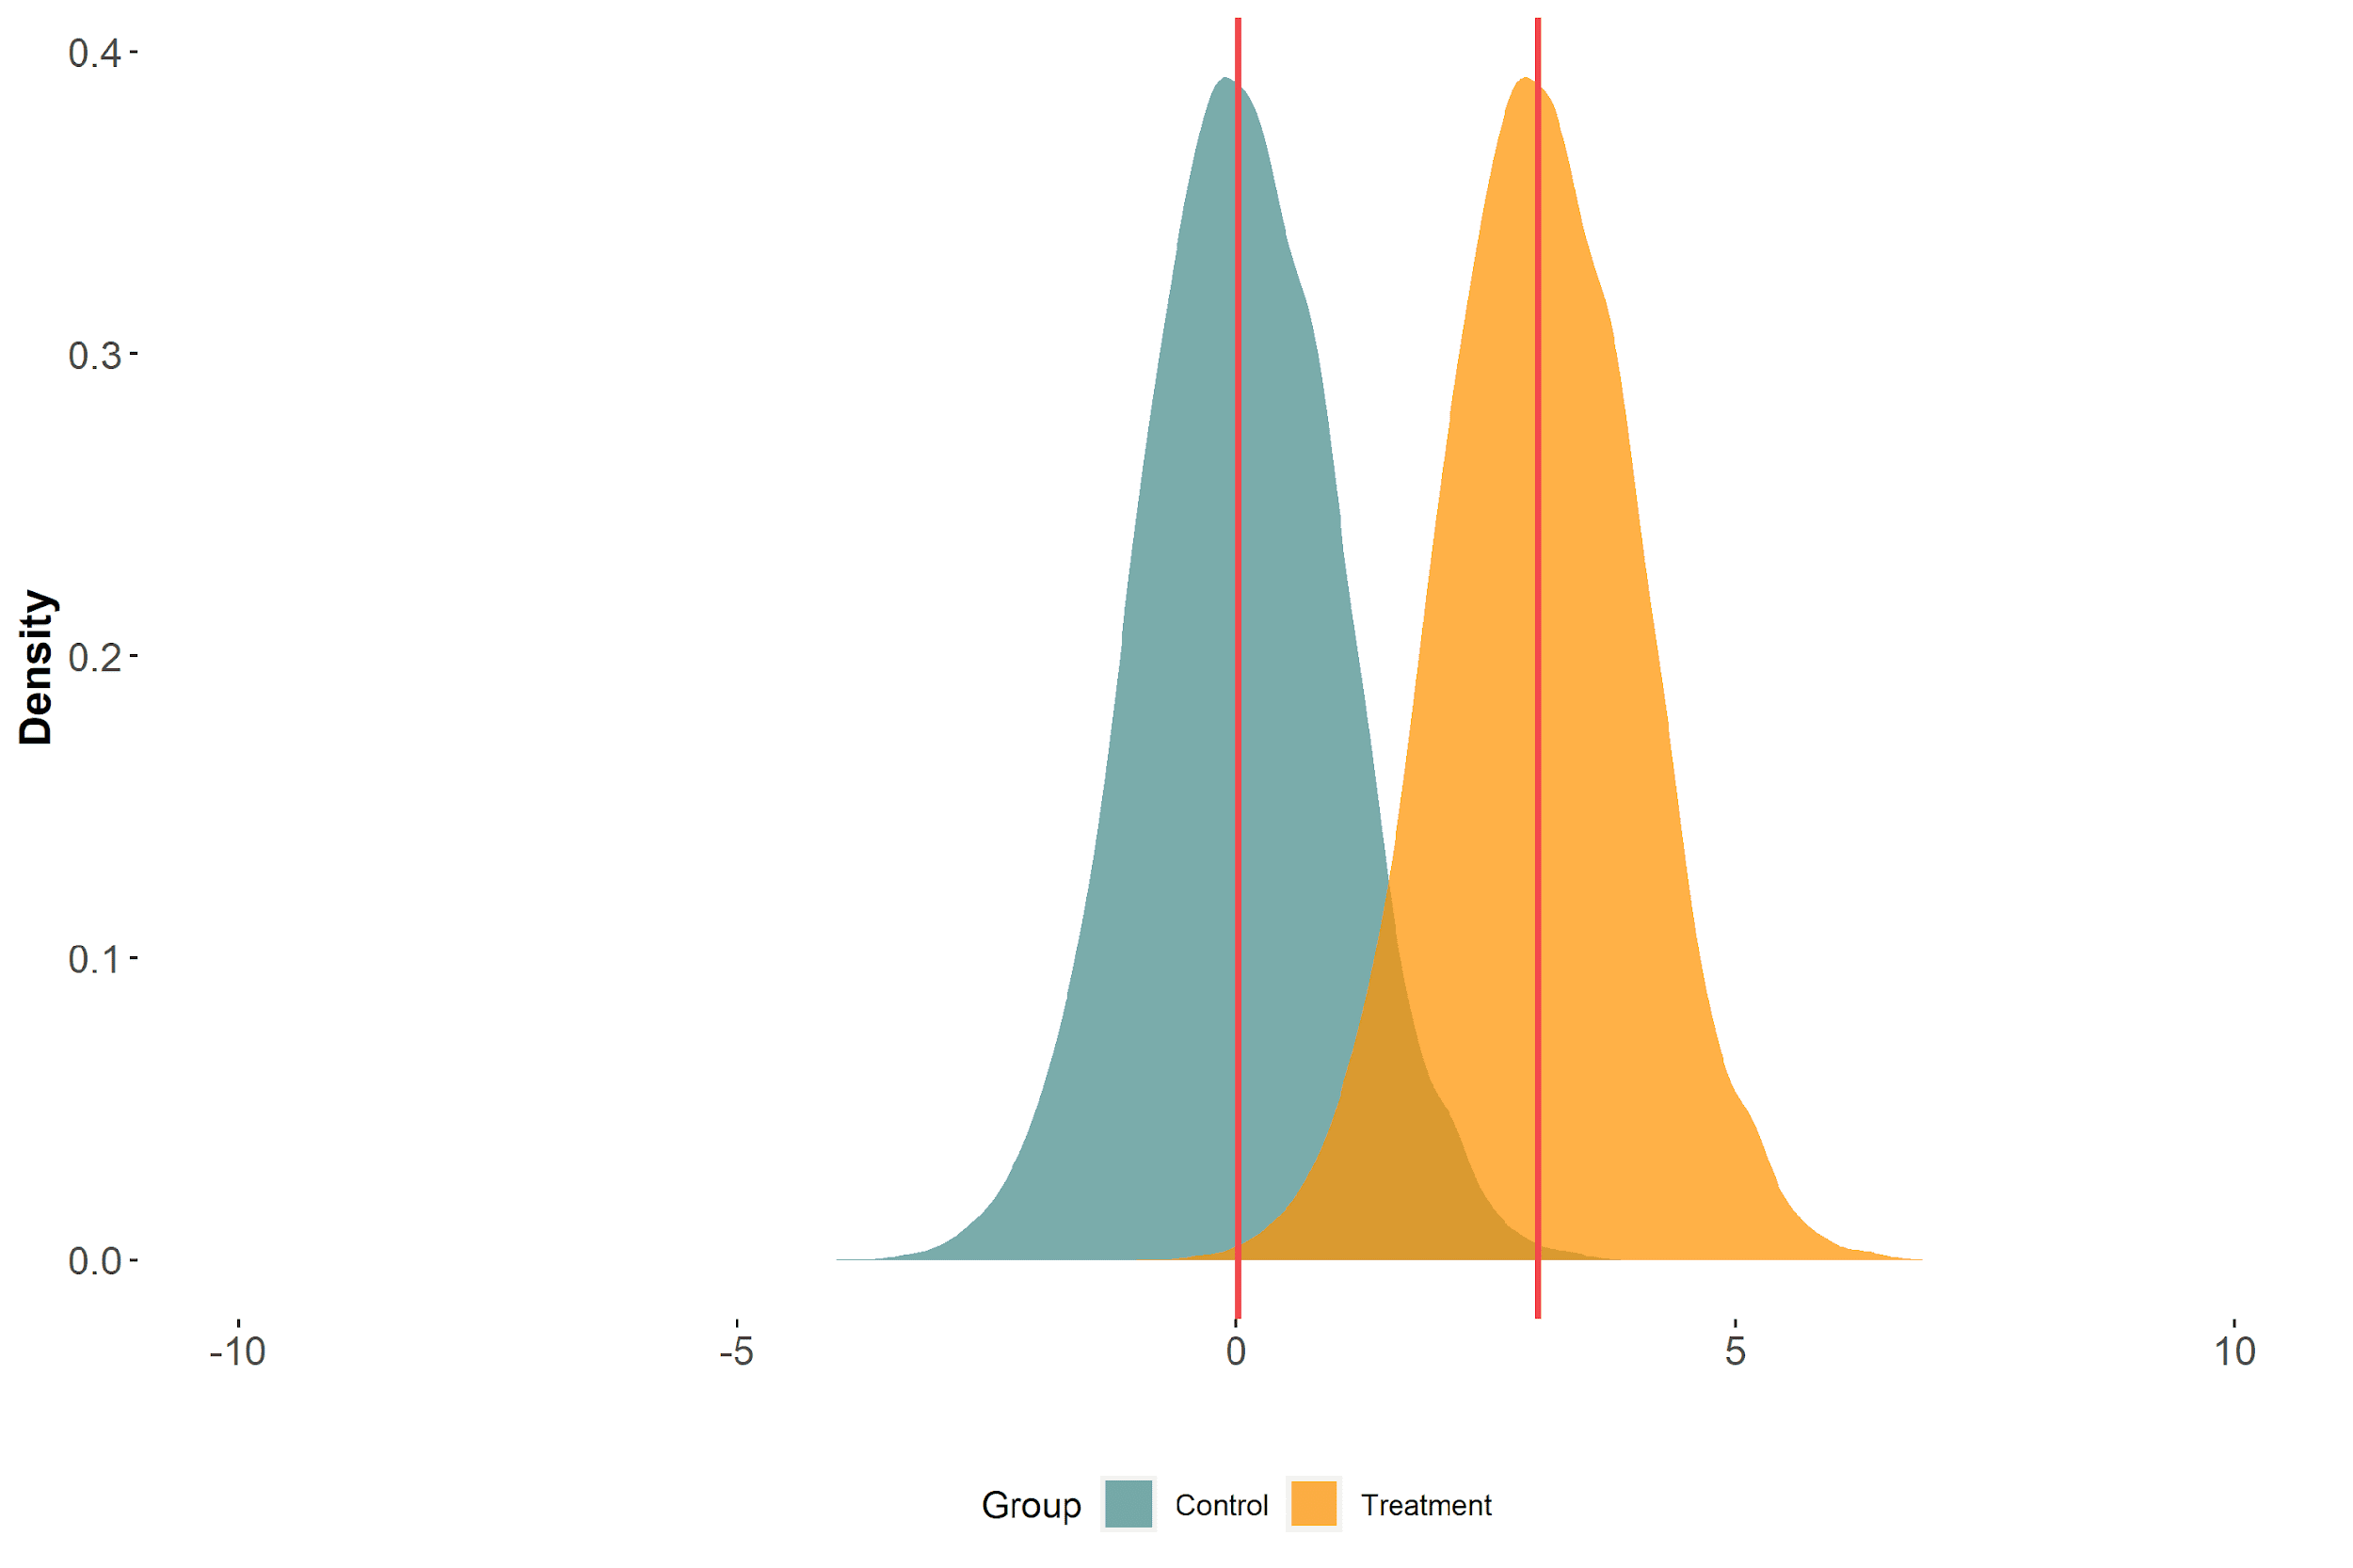
Imagine that a treatment shifts the outcome distribution uniformly
Notes:
Think about how the distribution itself is impacted by an exposure – 2 ways it can change, can be uniform shift or scale shift

Slide 64
Difference in means

Slide 65
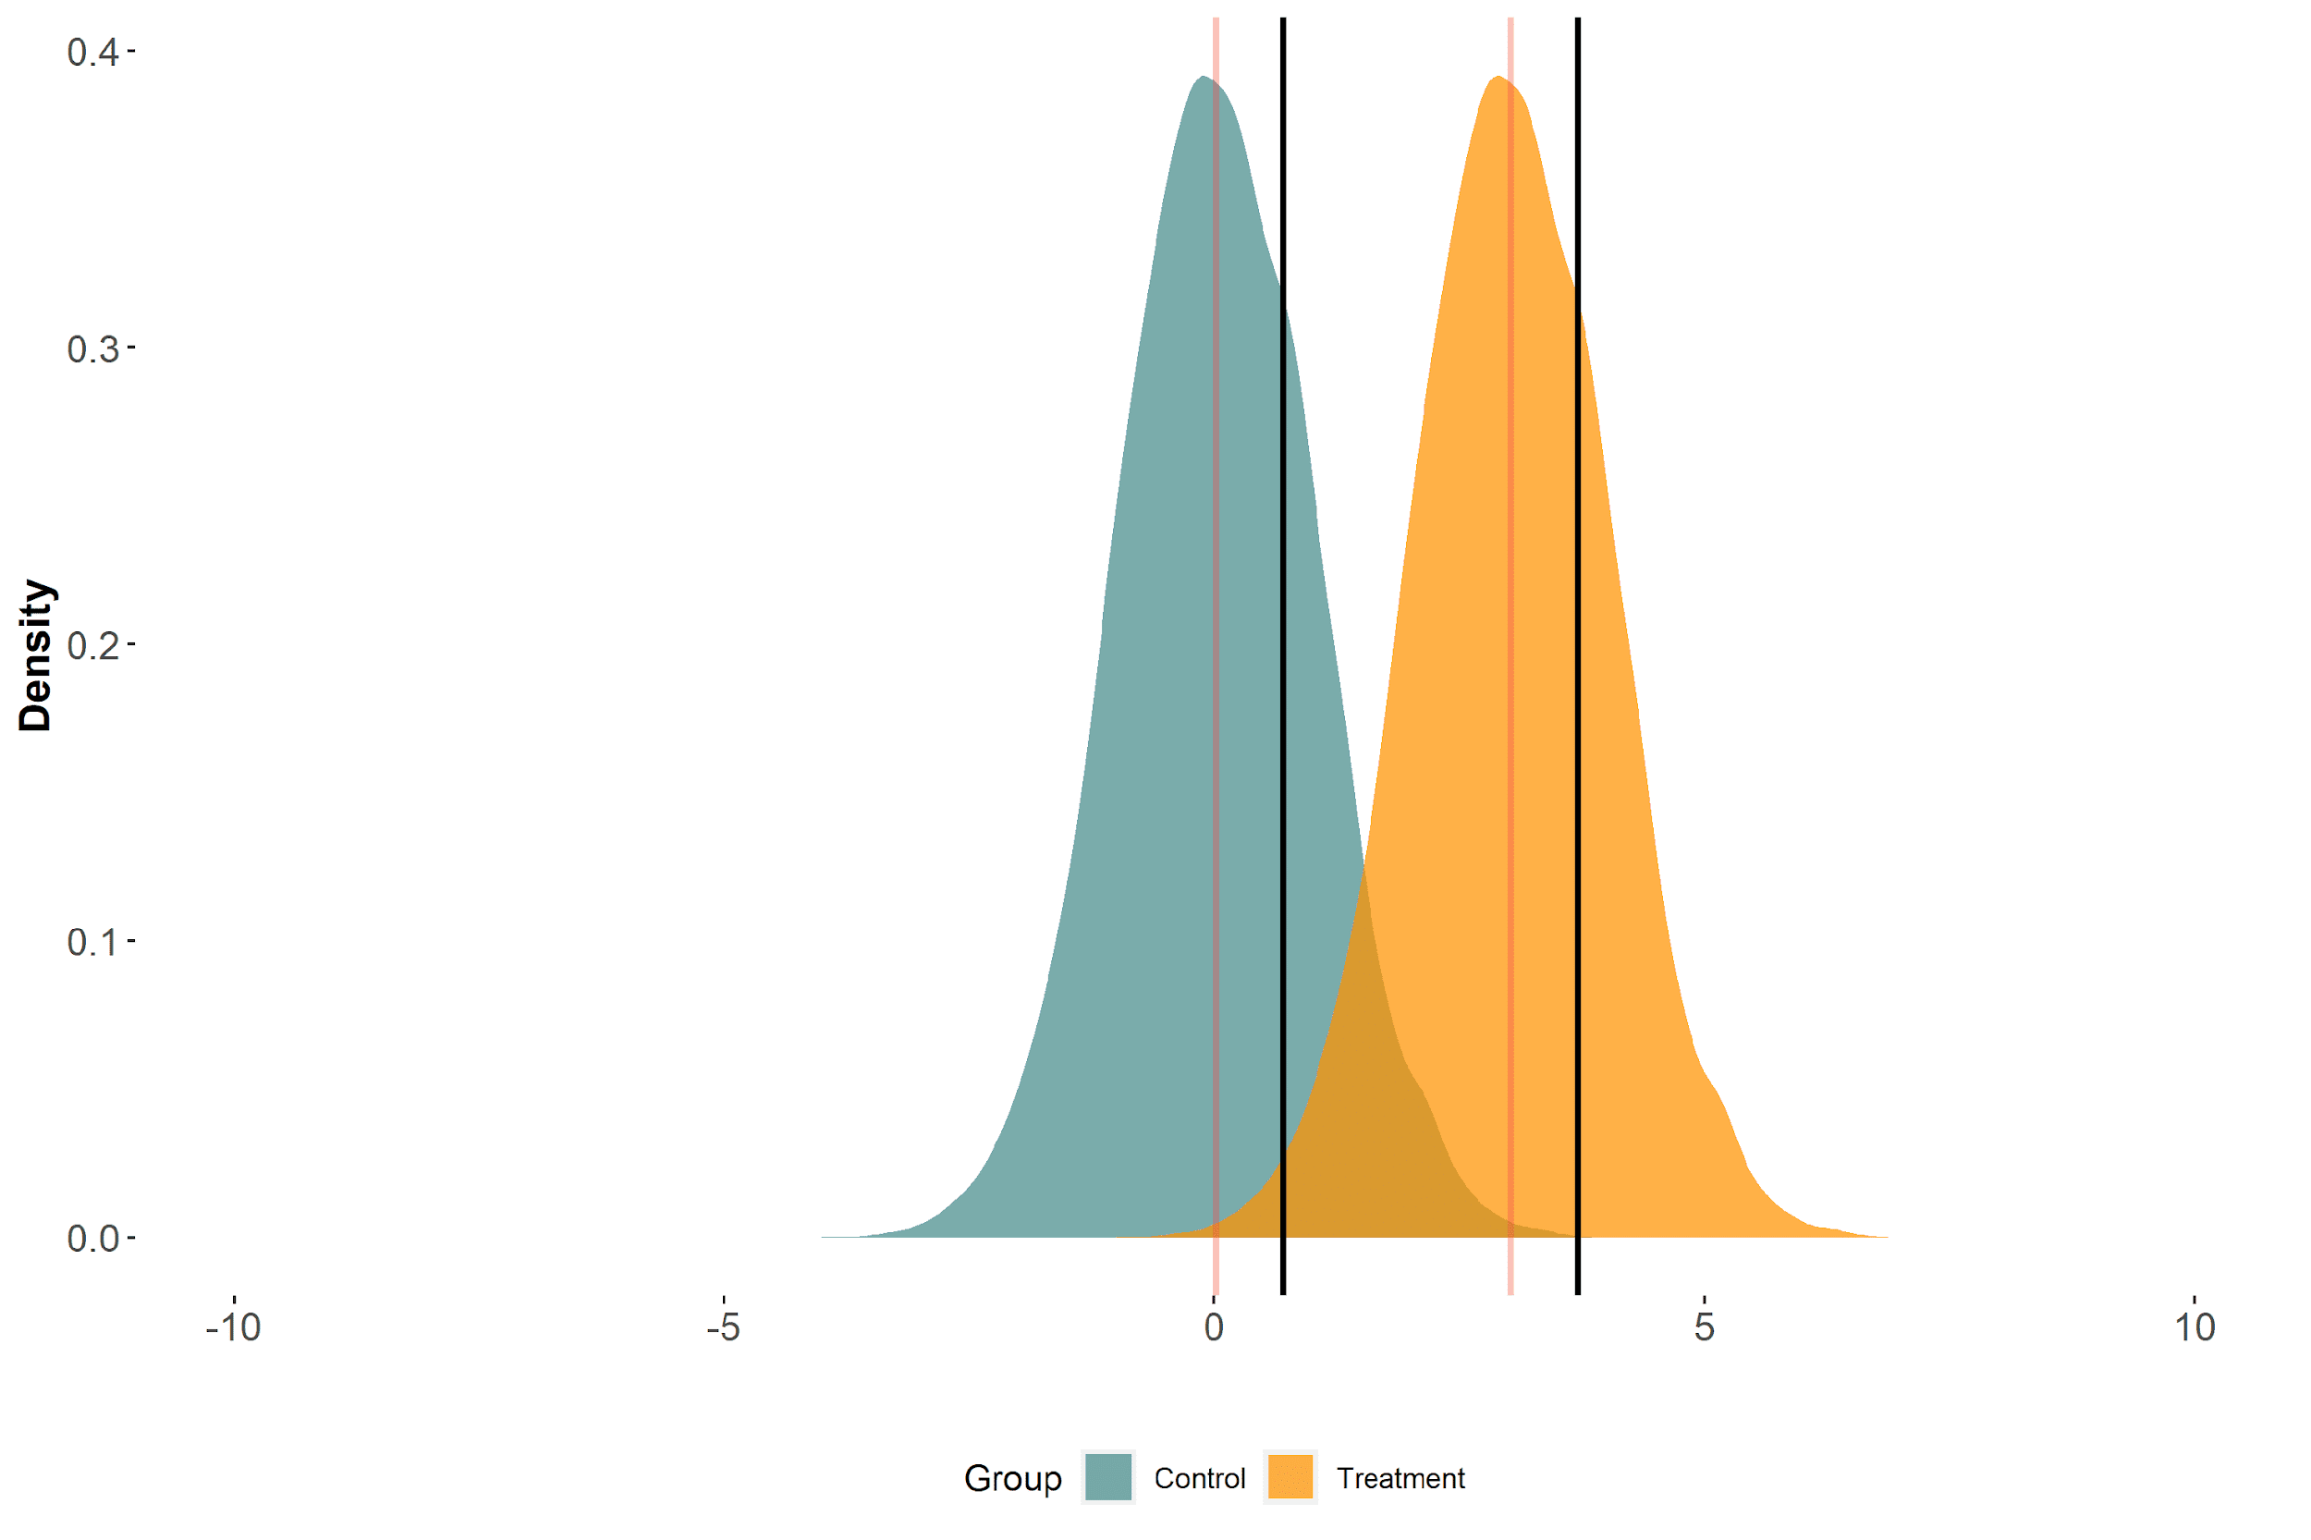
Difference in means = difference in 75th percentiles

Slide 66
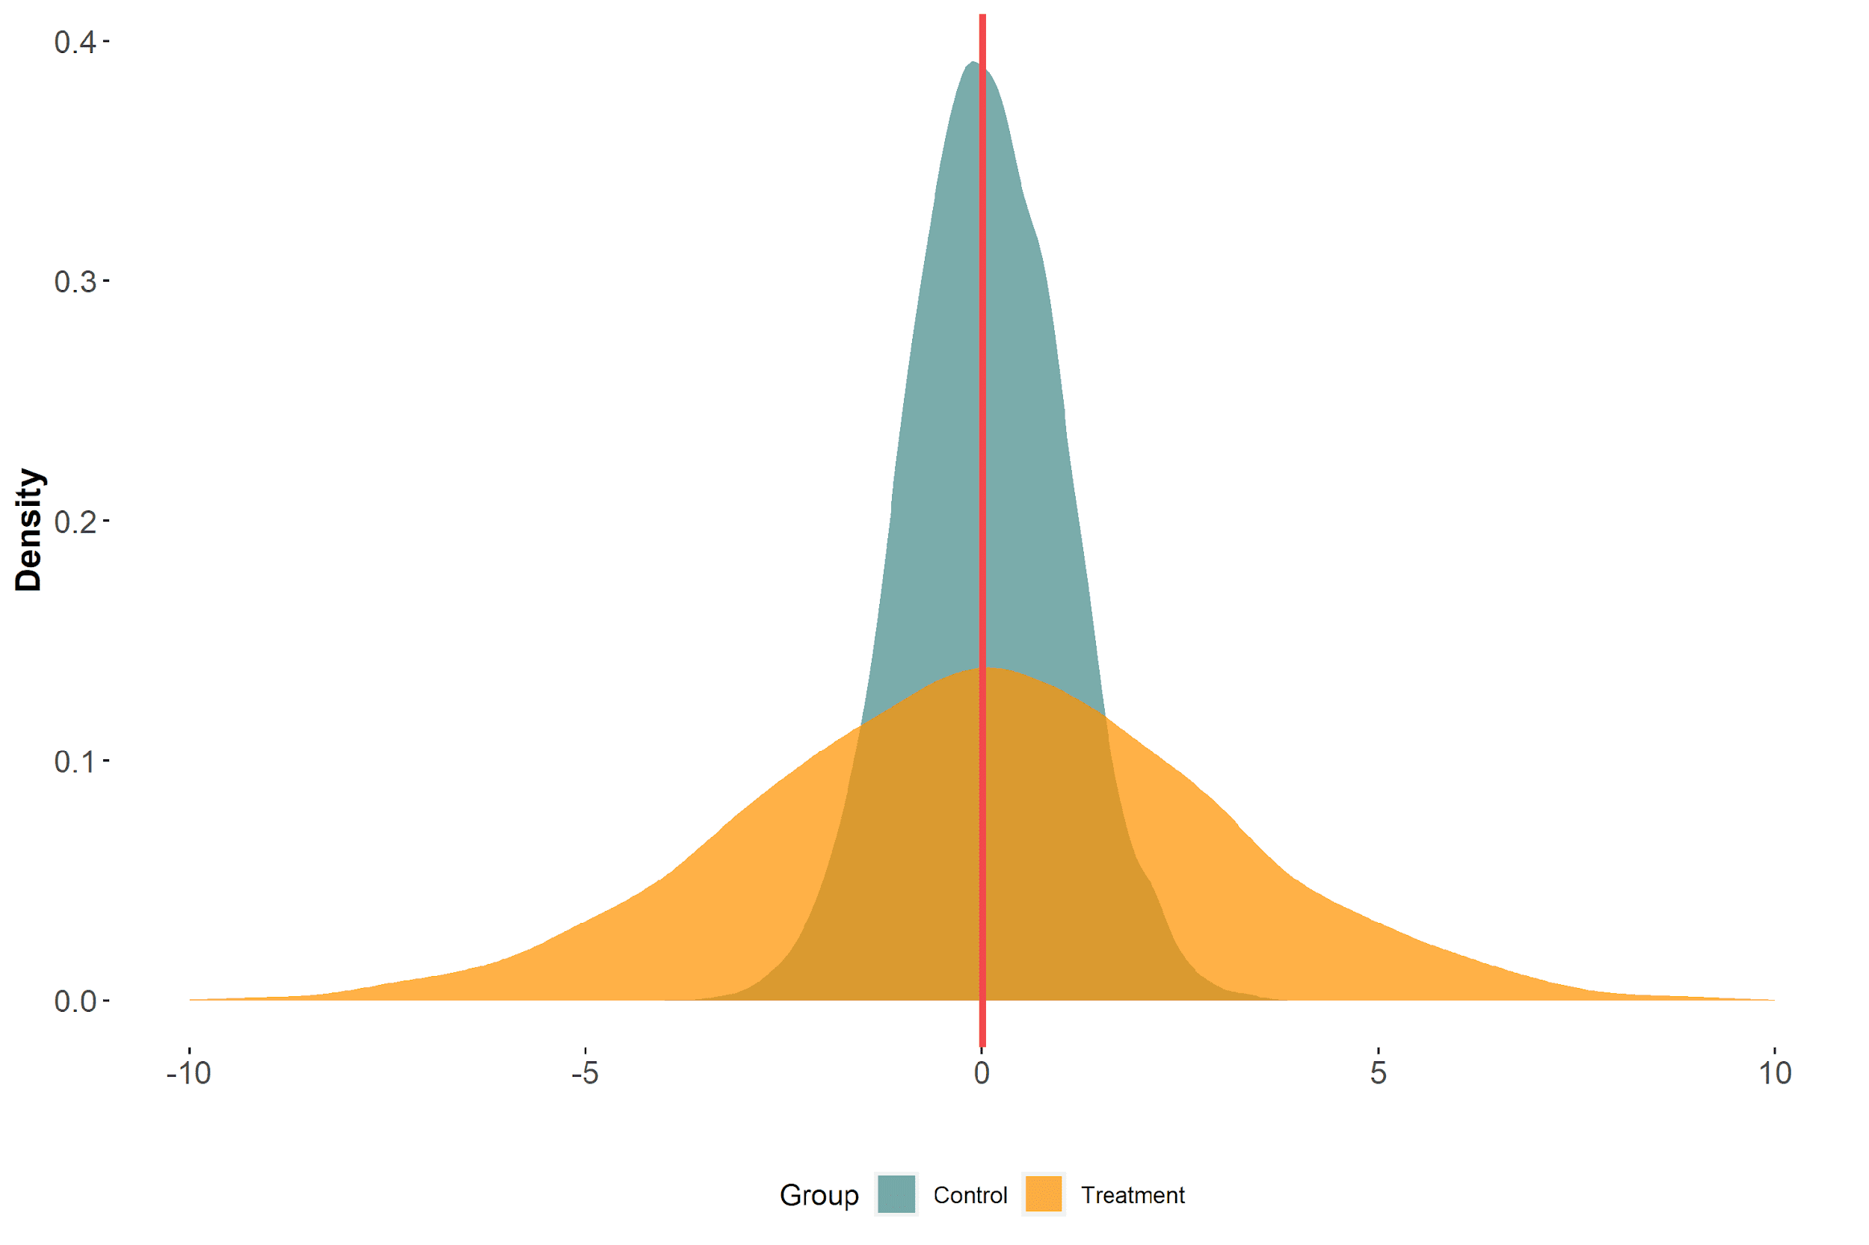
Imagine that a treatment affects the outcome distribution’s scale only

Slide 67
Difference in means

Slide 68
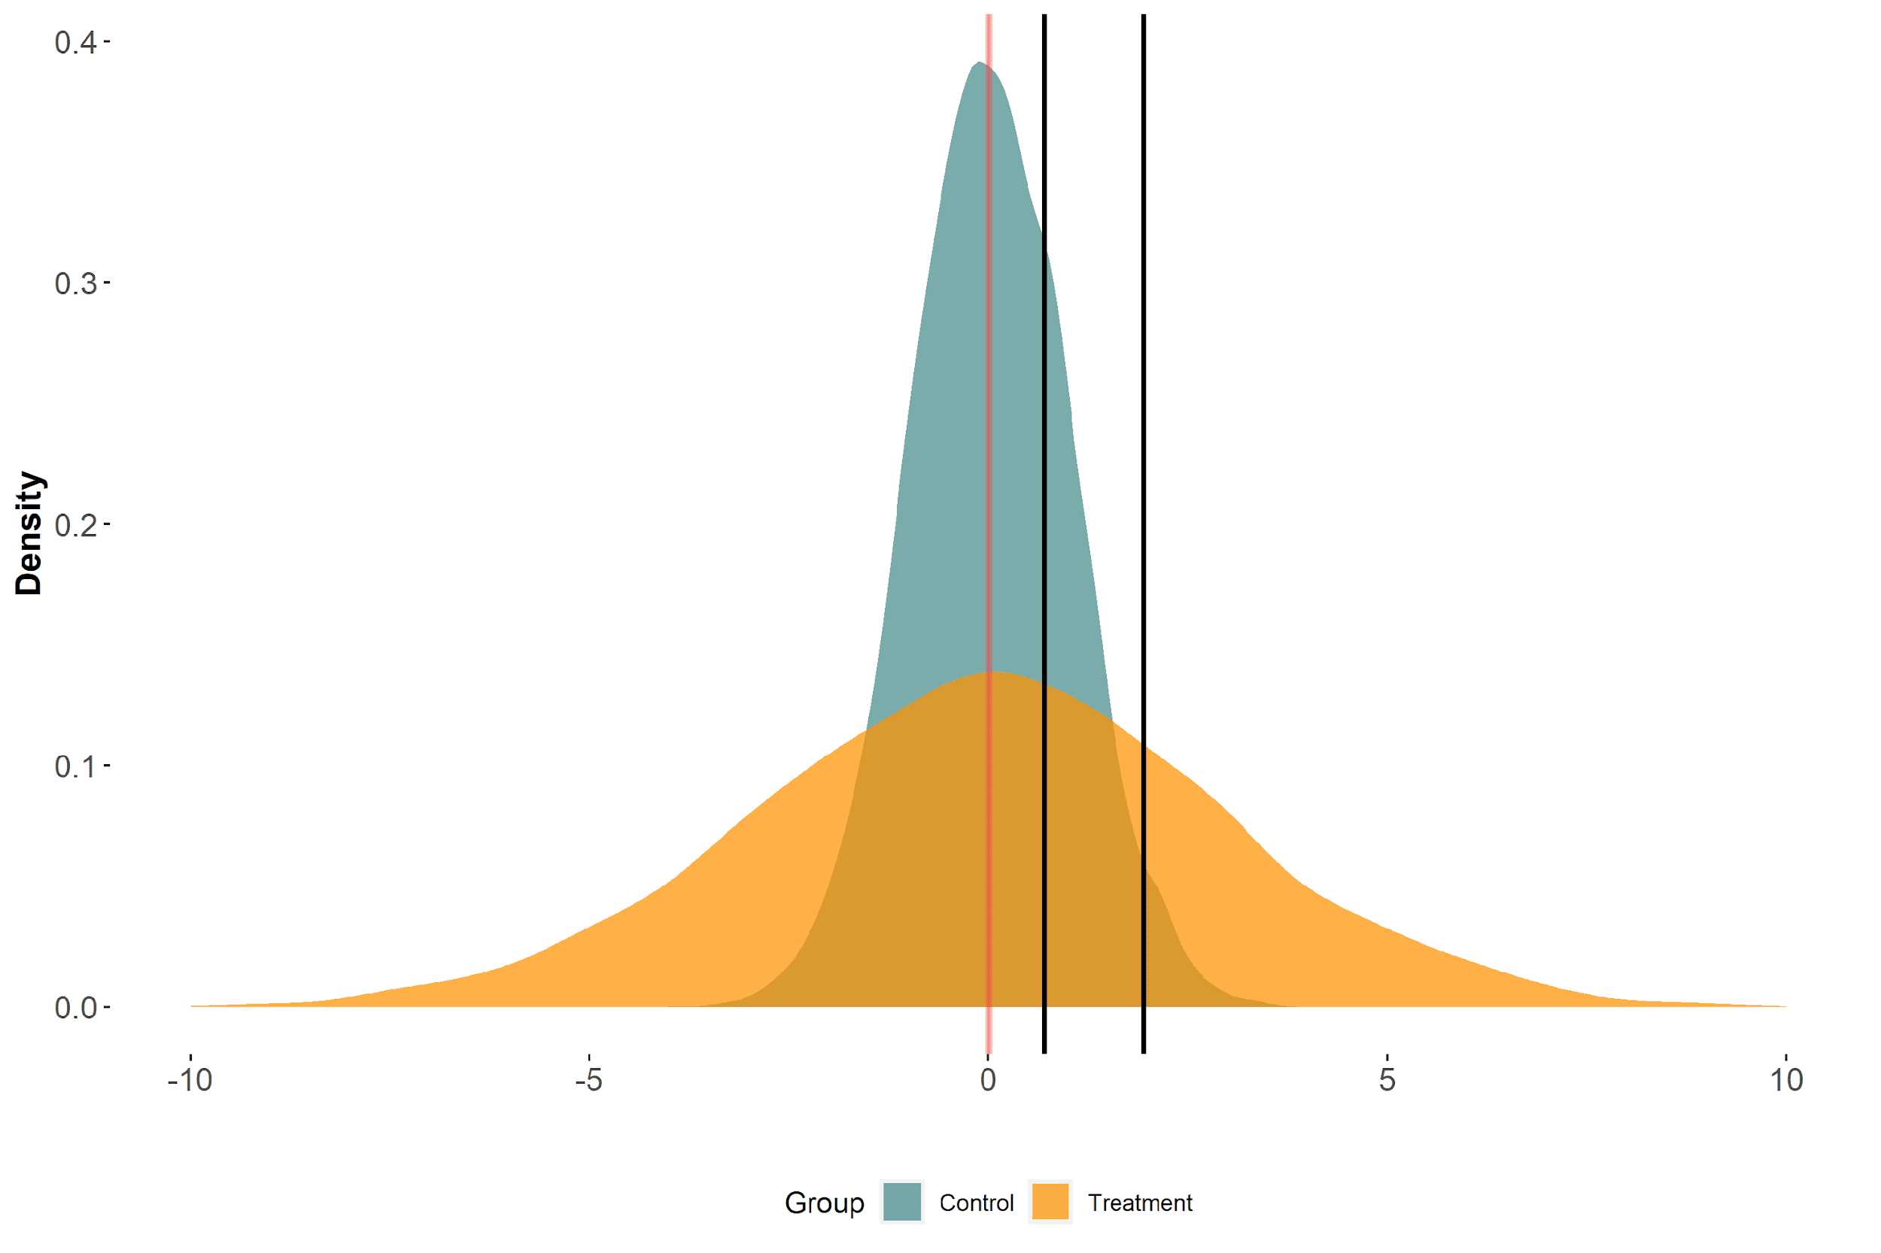
Difference in means ≠ difference in 75th percentiles

Slide 69
Means may tell tall tales about tails (repeat that 5 times fast)

Slide 70
But in reality, the changes might not be so dramatic
Notes:
And in turn the effect associated with a change in our exposure?

Slide 71
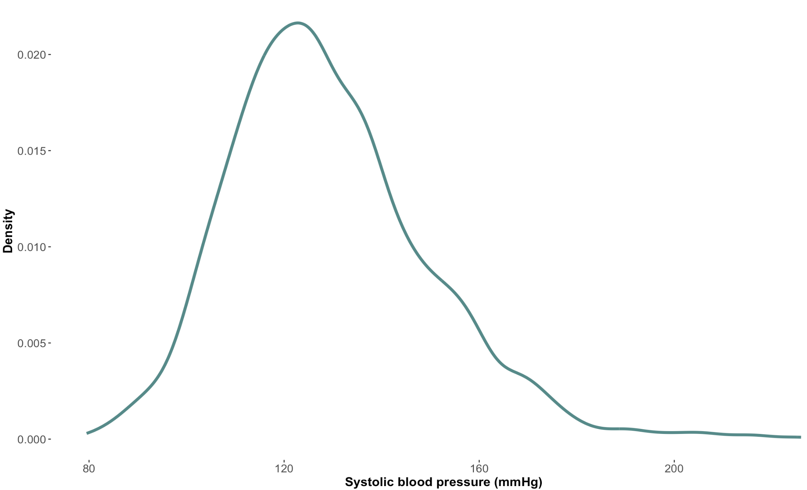
Distribution for participants with 12 years of education

Slide 72
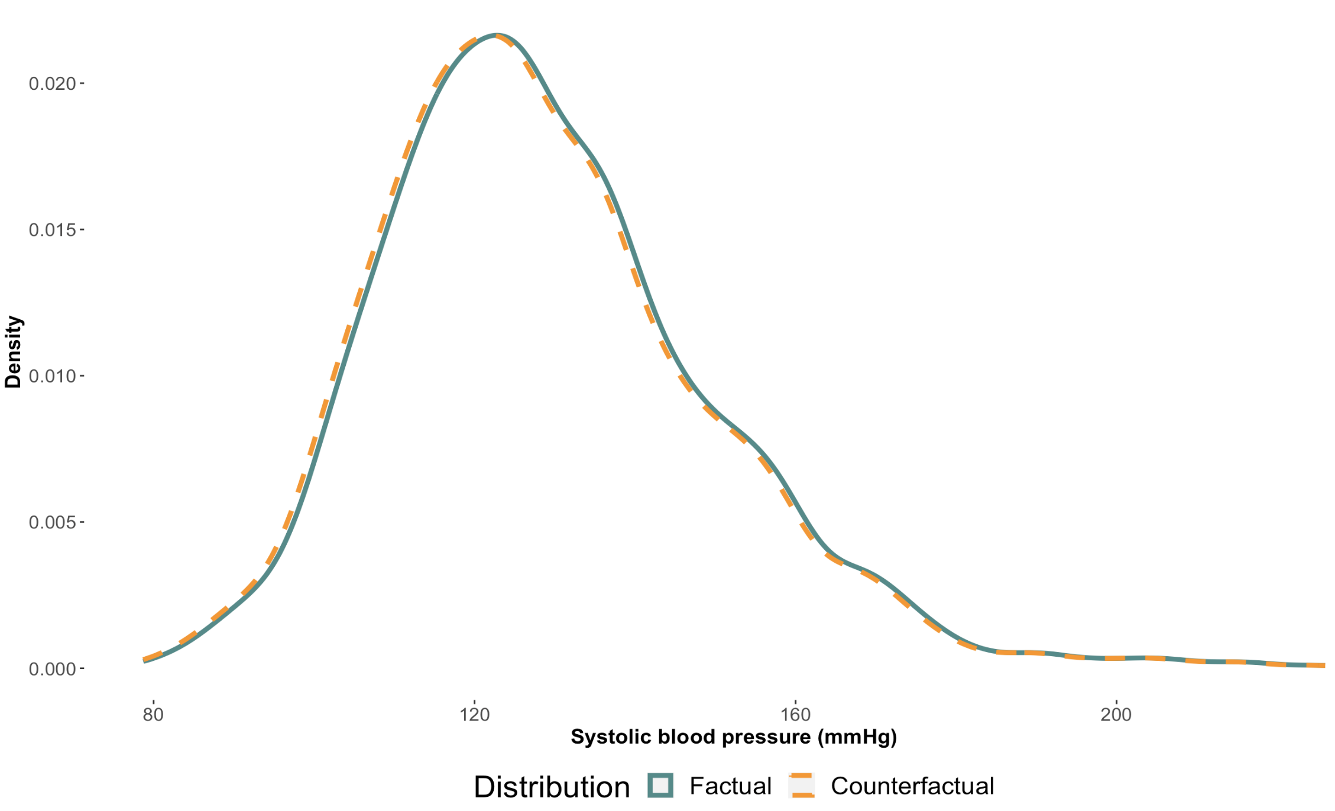
Linear Regression Counterfactual Distribution (12 years)
Notes:
Uniform change of -0.77mmHg (which comes from the coefficient from the adjusted OLS model)
Will go over how to create this graphic later
(the -0.77mmHg coefficient is for 12 years only, not the original coefficient we went over for the entire sample which was -0.8mmHg)

Slide 73
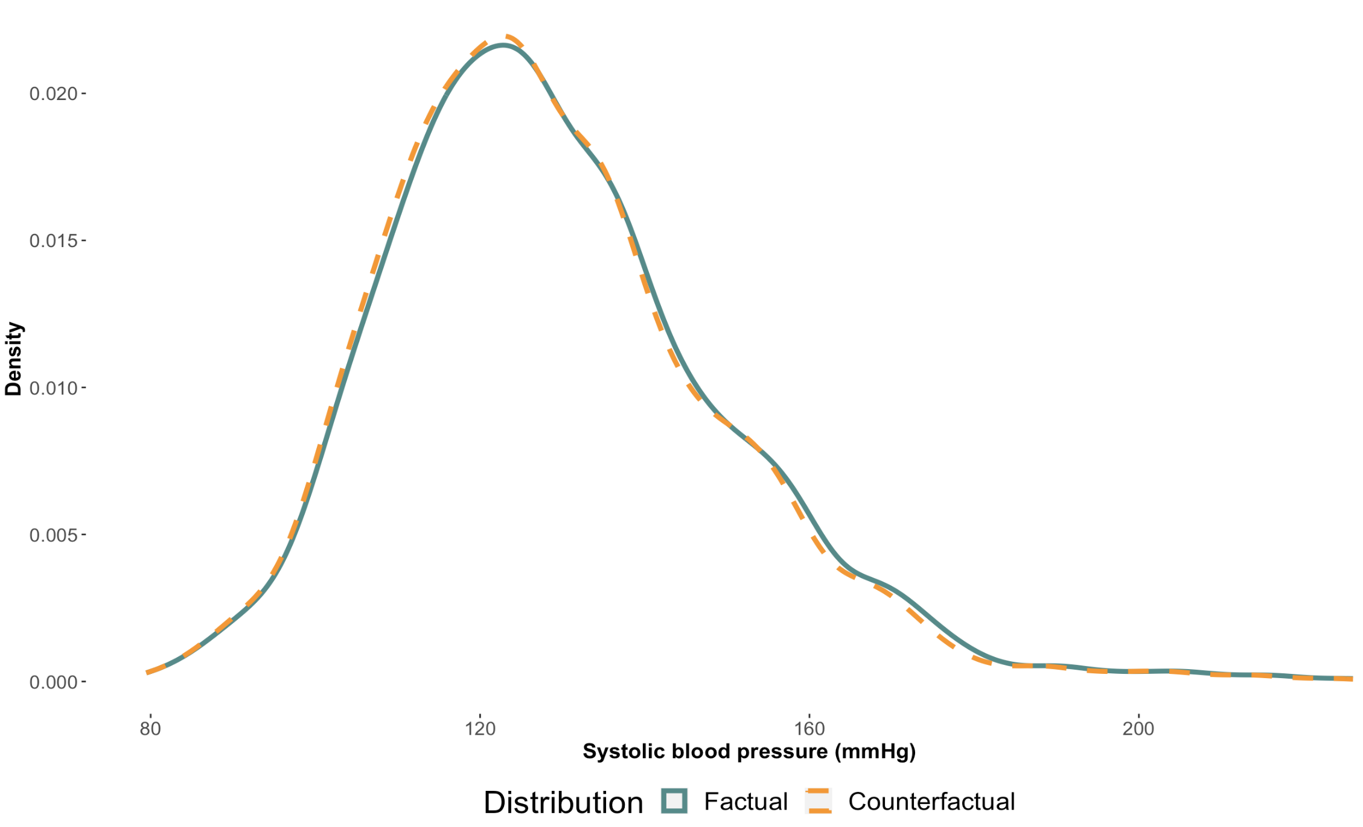
CQR Counterfactual Distribution (12 years)
Notes:
Non uniform change

Slide 74
Why do we care about distributions?
Notes:
And in turn the effect associated with a change in our exposure?

Slide 75
The tails matter too: case of blood pressure
This figure is a recreation of a figure from Fuchs et. al. (2020 with simulated data.
Notes:
Empirical reality; why we want to know about how an exposure might affect difference parts of a distribution. (would really want to impact the higher quantiles of outcome)
20 mmHg change from 120-140 is an increase of 32 in absolute risk, but a 20mmHg change from 160-280 is an increase of 128 (double) of absolute risk
Can mention other examples like birth weight, econometrics stuff like wages etc.

Slide 76

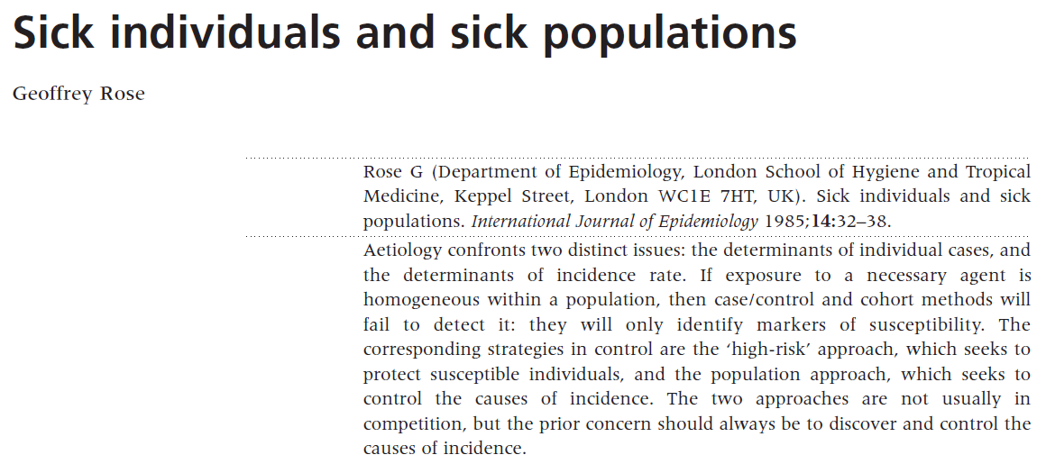
“Geoffrey Rose’s big idea”*
*The title of this slide comes from a Commentary written by A Hofman and JP Vandenbroucke (1992). Link
Notes:
Now, HOW we address what happens in those tails may change depending on what lens we’re viewing things through. Geoffrey Rose was contrasting determinants of disease in individuals with determinants of disease in populations
Geoffrey Rose – highly influential paper, talked about the need to have a population approach for prevention of disease rather than the high-risk approach that is more common in the clinical setting.
Note: The title of this slide is also the title of a 1992 commentary on Rose’s work. Link: https://www.ncbi.nlm.nih.gov/pmc/articles/PMC1884728/pdf/bmj00105-0011.pdf

Slide 77
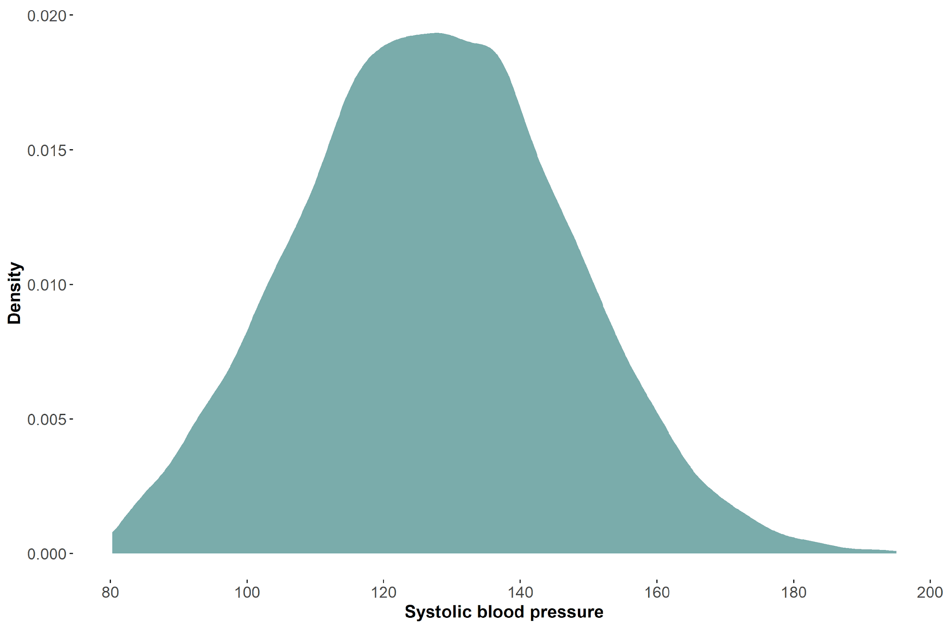
Illustrating Rose’s big idea

Slide 78
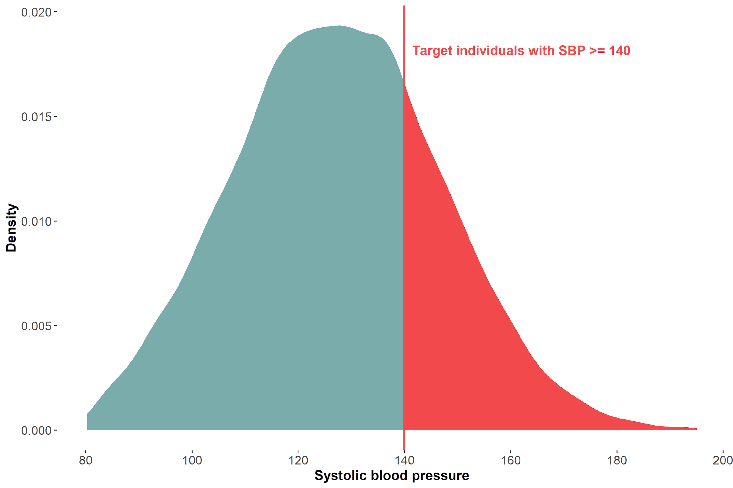
High risk approach for prevention

Slide 79
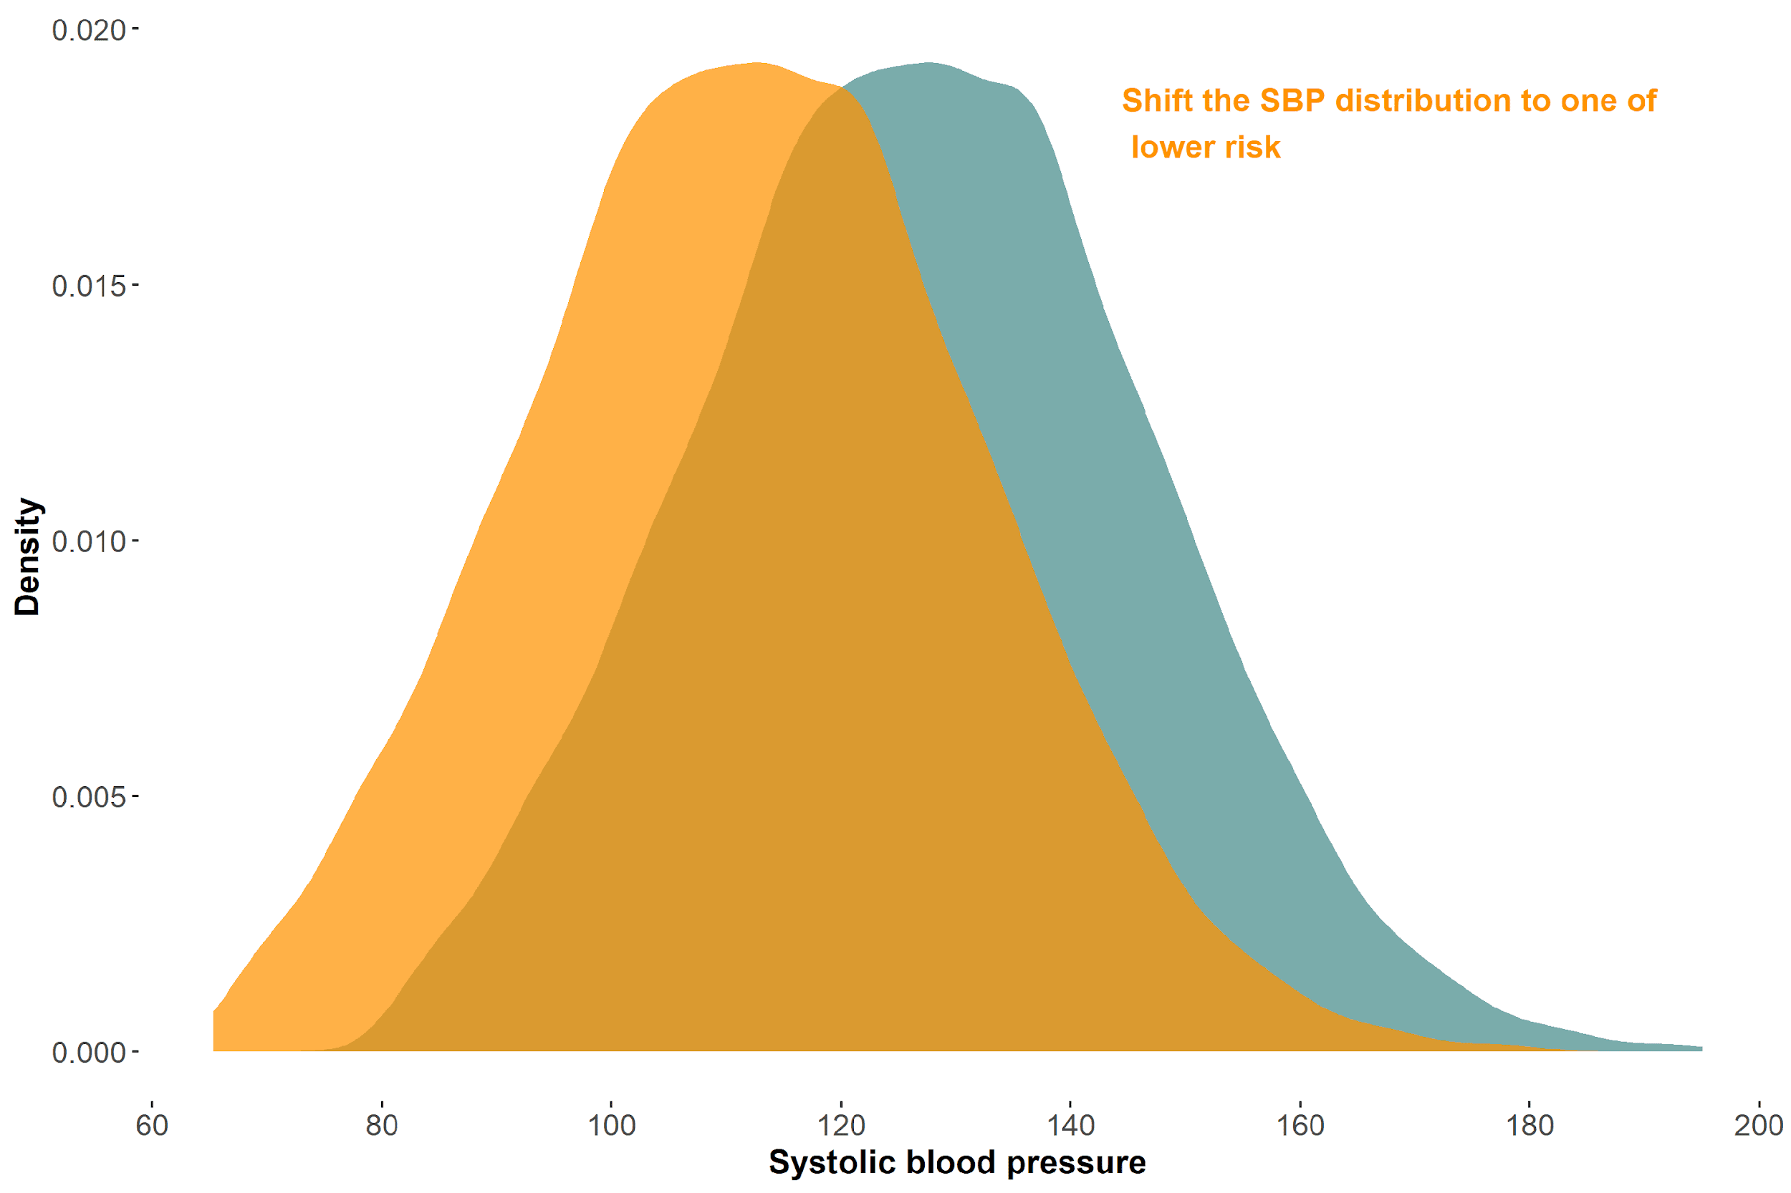
Population approach for prevention

Slide 80
Prevention approaches
High risk approach is useful when…
There are identifiable risk factors that can be targeted in specific individuals/groups
Effective interventions are available for high-risk populations
Targeting individuals can lead to significant reductions in disease incidence or severity
Resources are limited
Population approach is useful when…
Addressing social determinants, environmental factors, or behavioral norms can lead to population-wide improvements in health outcomes
The disease or health issue is widespread across the population
There are opportunities for policy changes or community-level interventions
Preventative measures benefit from reaching a broad audience (e.g., vaccinations)

Slide 81
Equity in Epidemiology (and Research)
Population level interventions address structural determinants of health which primarily tend to affect minoritized and other structurally disadvantaged populations
Quantile regressions offer a more nuanced way of evaluating population interventions
Notes:
This is of particular importance in this political moment when research that’s explicitly about minoritized group may be penalized, not funded, etc. This can be kind of a “backdoor” approach to address disparities in population health

Slide 82
Any other reasons to use quantile regressions?

Slide 83
Quantile regressions are robust
Quantile regression estimates are usually unaffected by:
Outliers in the outcome
Monotonic transformation of the outcome (e.g., natural log)
Top coded or bottom coded outcomes
Notes:
Statistical properties

Slide 84
How does an outlier change the distributions? (SBP = 1,000,000)
Mean
Without outlier: 127.63mmHg
With outlier: 240.28mmHg
75th Quantile
Without outlier: 138.50mmHg
With outlier: 138.50mmHg

Slide 85
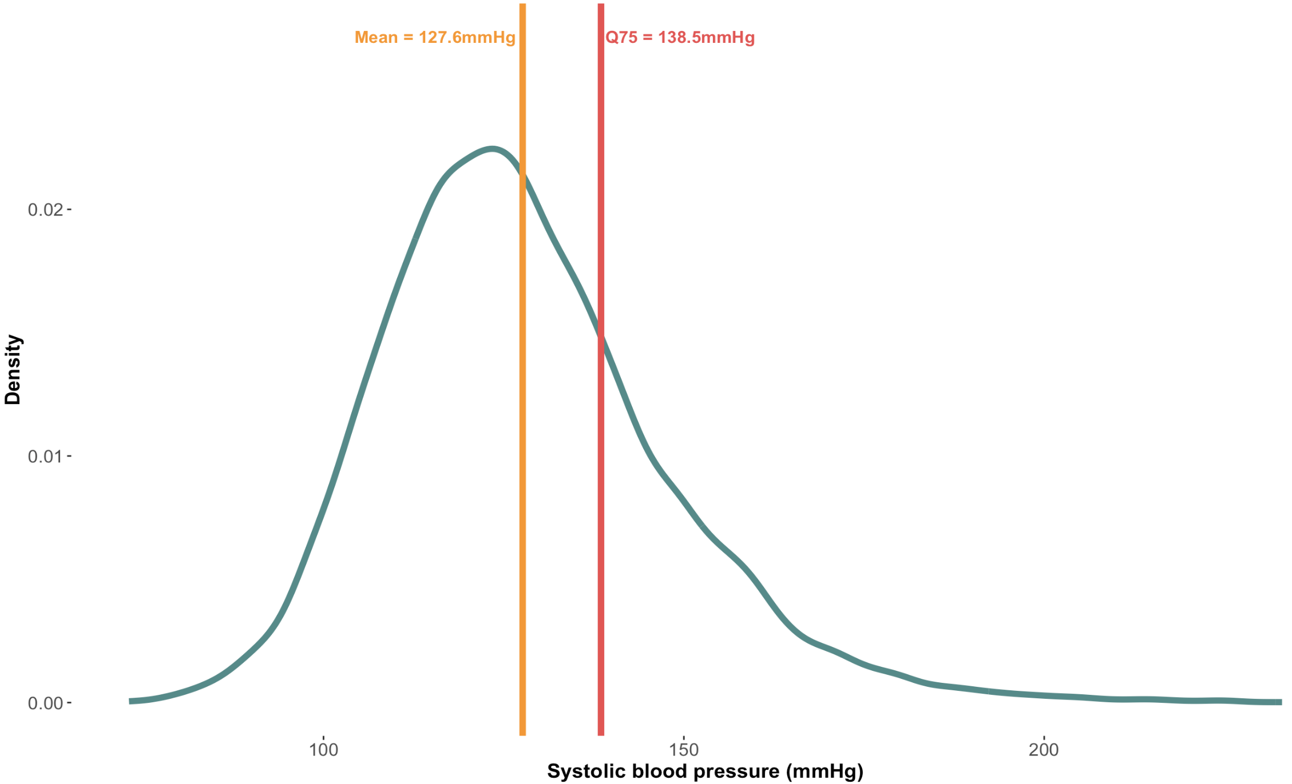
Distribution of SBP in our sample
Notes:
Once again, this is the distribution of SBP in our sample showing the mean and the 75th quantile, we’ll be illustrating the rest of the examples graphically & this is our starting point. Incidentally, may notice quite a few people with SBP above 150→ what if we wanted to top code this?

Slide 86
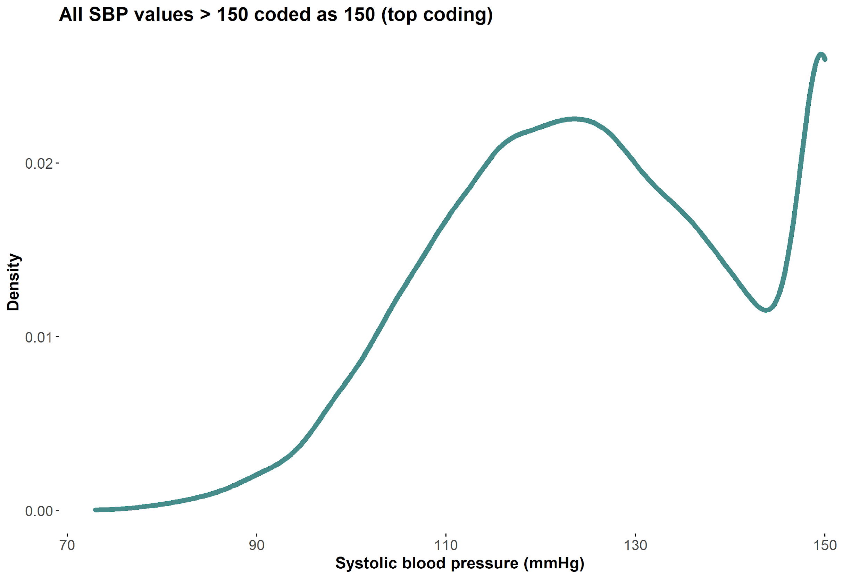
Robust quantiles: Most quantiles unaffected by top/bottom coding
Notes:
R code: fit top/bottom boded version of data and compare how the coefficients change

Slide 87
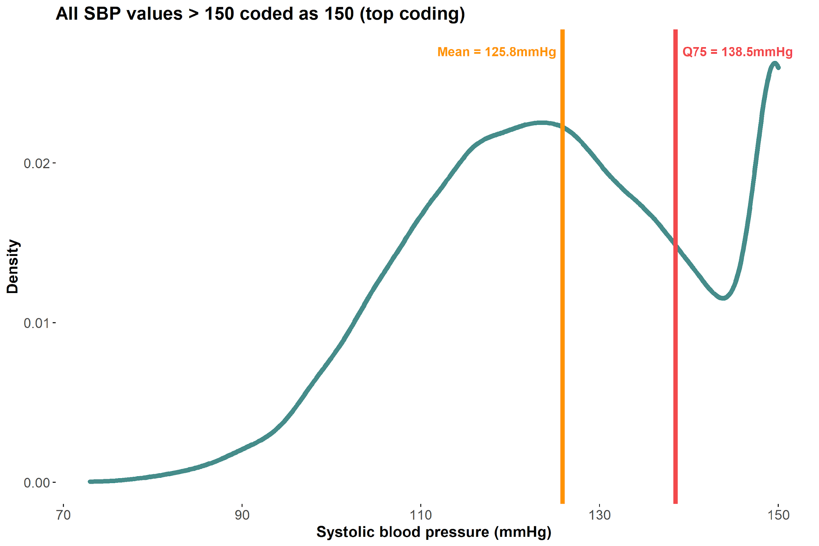
Robust quantiles: Most quantiles unaffected by top/bottom coding
Mean changed from 127.6mmHg to 125.8mmHg, but the 75th quantile did not change!
Notes:
Because the quantiles aren’t changing, you can make the argument that the associated estimate on school years would be the same for quantile regression at the 75th quantile, but a linear regression estimate would change/be skewed due to the change at the mean when including an outlier or top coding

Slide 88
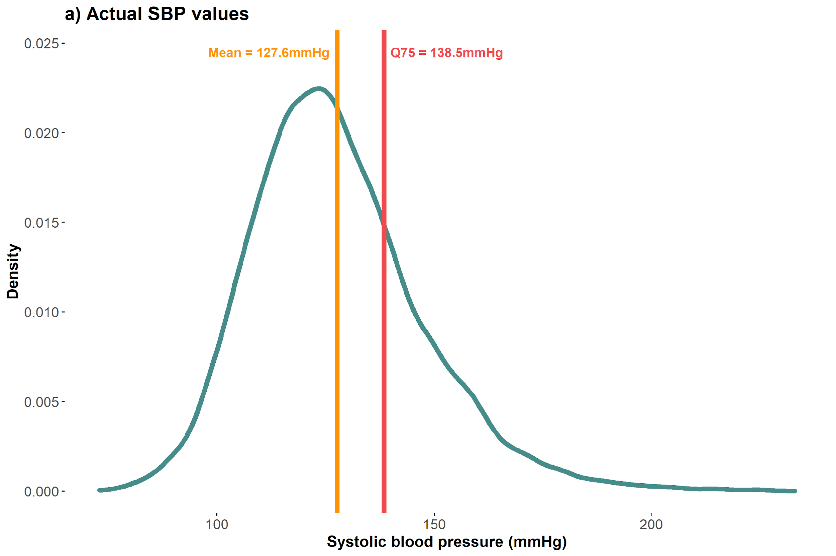
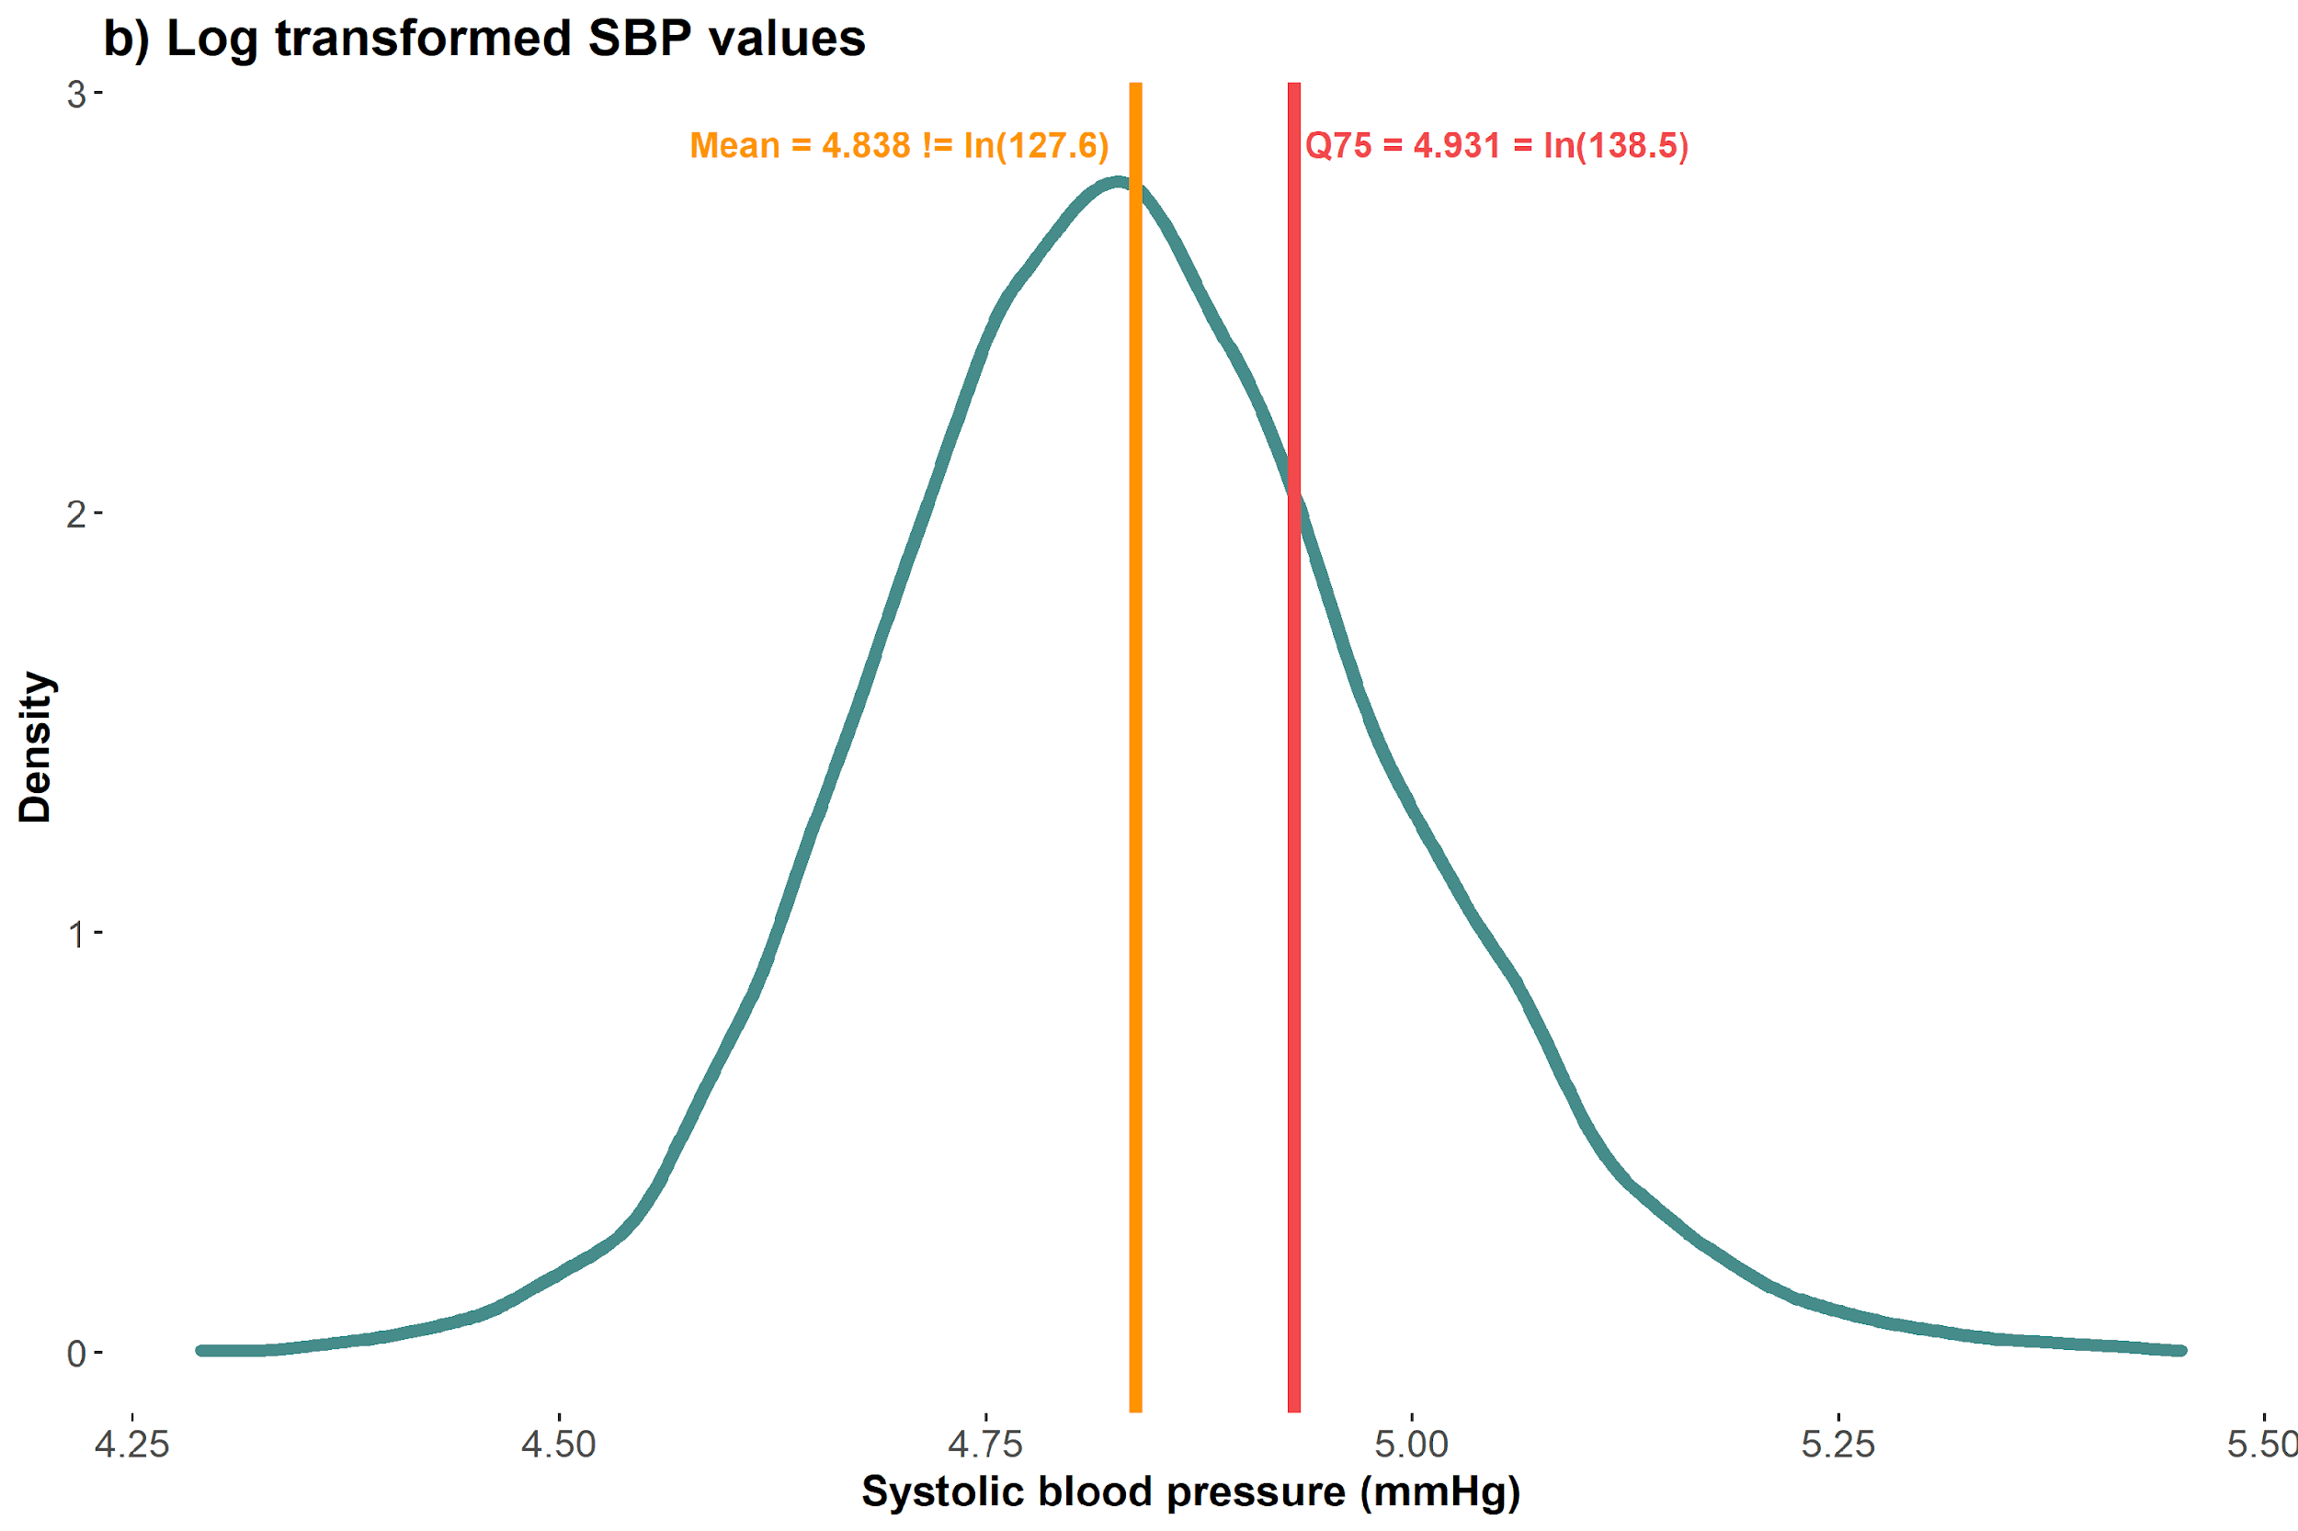
Robust quantiles: Equivariance to monotonic transformations
Notes:
Log(127.6) = 4.85 (but mean of log transformed distribution is 4.84); would be a larger change if we transformed a variable with a skewed distribution
Log(138.5) = 4.93 (75th quantile of the log transformed distribution)
Why do you think this is important? Extrapolation

Slide 89
10-minute break

Slide 90
Poll Time!
Notes:
Up to this point we’ve been talking about CQR, but we’ve also mentioned another type of QR, UQR. As a starting guess, we don’t expect you to know the answer

Slide 91
Why can(’t) we use CQR estimates to to get estimates for the unconditional distribution?
Technically possible…
Computationally difficult ☹
Notes:
Technically possible under certain conditions, not always

Slide 92
According to Borah and Basu (2013)
Conditional quantile regressions quantify contrasts of the unconditional outcome distribution if:
Outcome is only a function of the exposure
Exposure induces only a location shift in the outcome in the presence of other covariates
But not if
Exposure interacts with other covariates in the DGP

Slide 93
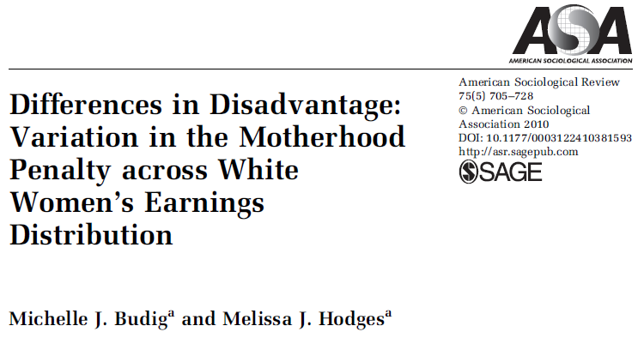
Controversy about the motherhood wage penalty for low-wage women
Notes:
As we’re wrapping up the CQR section, let’s take a look at an example of when using CQR is not appropriate

Slide 94
Variation in motherhood wage penalty Budig et. al. (2010)
Several studies show there is a motherhood wage penalty for American women
Does the penalty vary for low-wage vs. middle-wage vs. high-wage workers?
Methods:
Data: National Longitudinal Survey of Youth, a nationally representative longitudinal study of individuals aged 14-21 in 1979 (1979-2004 waves)
Exposure: Total number of children reported at time of interview
Outcome: Natural log of hourly wages, top- and bottom-coded at $1 and $200
Analysis: conditional quantile regression model

Slide 95
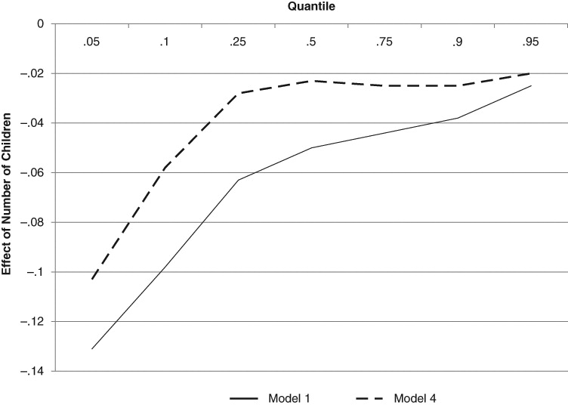
“Mothers who can least afford to lose wages are the ones incurring the largest proportionate penalties”
Notes:
This graph shows 2 different models the authors ran, just differing in terms of what covariates they included, but same exposure/outcome. In both cases, shows that at low quantiles of wages, each additional child decreases the mother’s wages more compared to the effect sizes in the mid- to high quantiles

Slide 96
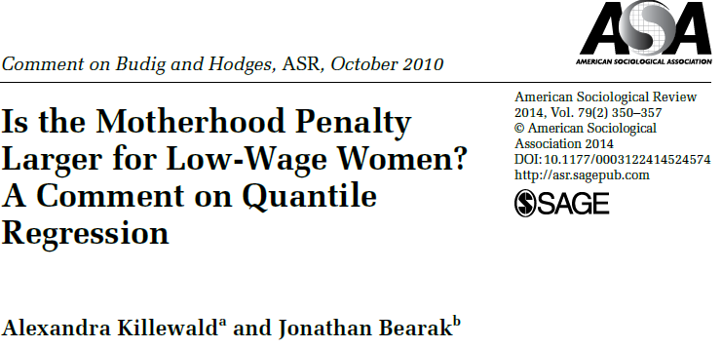
A combative commentary on the Budig et. al. paper
Notes:
Would recommend this commentary especially in trying to understand these methods from a non-technical perspective and when to use conditional vs. unconditional QR

Slide 97
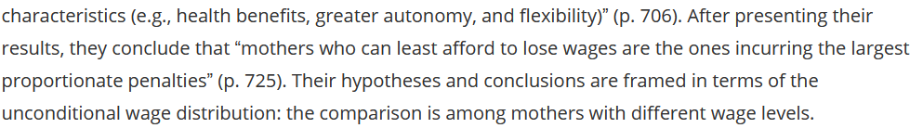
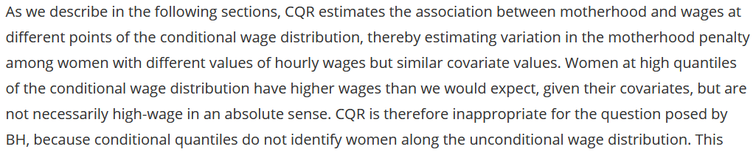
Killewald’s key critique
Notes:
First box – problem with this is that CQR is using conditional wage distribution, which estimates variation in the motherhood penalty among women with different values of hourly wages but similar covariate values.
Second box
As an example, we could think about a woman who did not complete high school – she might have high wages relative to another woman who didn’t complete high school, but low wages compared to a woman who did complete high school

Slide 98
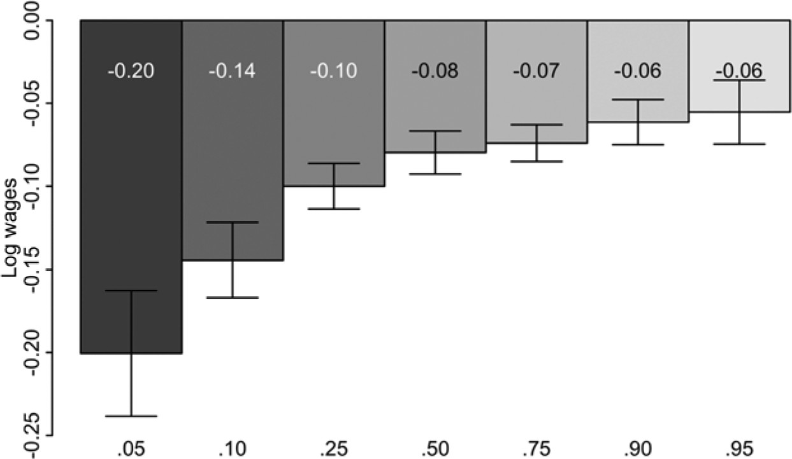
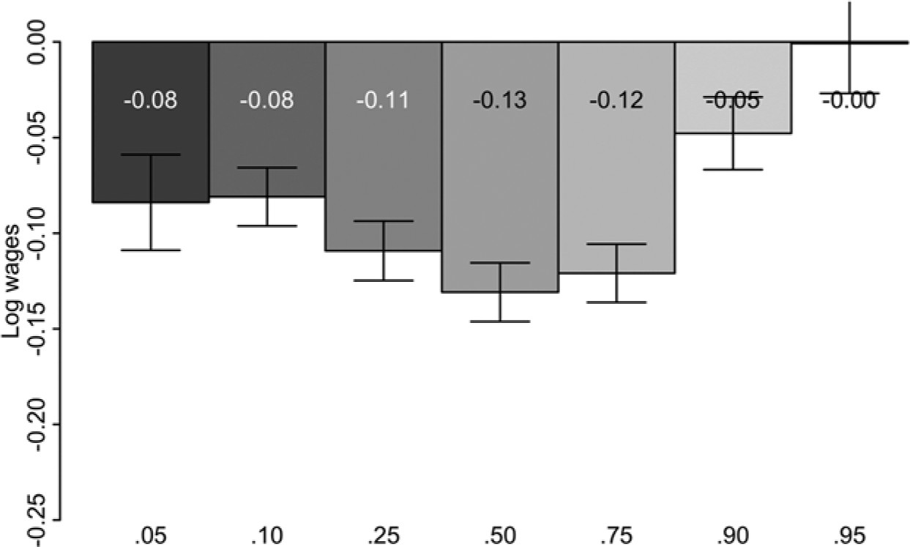
More appropriate method changes the main results!
Killewald et. al.’s replication of Budig et. al. results by applying conditional quantile regression (Figure 1 of the paper)
Killewald et. al.’s results for the motherhood wage penalty after applying more appropriate methods (Figure 2 of the paper)
Quantile
Quantile
Notes:
On the left side they reproduced the Budig and Hodges results to be able to directly compare their own results. Then they did same analysis with UQR and found that mothers in the middle of the wage distribution actually had the largest penalty.

Slide 99
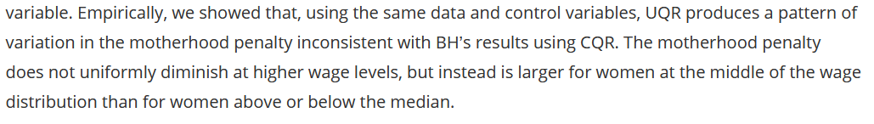
Implications of new results using appropriate methods
Notes:
Keep this in mind as we go through UQR, that they are estimating different things

Slide 100
Unconditional quantile regressions (UQR)
Notes:
Jilly

Slide 101


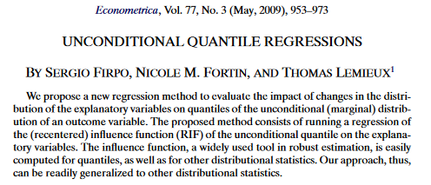

Sergio Firpo. Source: link
Nicole Fortin. Source: link
Firpo, Fortin, Lemieux (2009). Unconditional Quantile Regressions. Econometrica 77(3): 953-973
Thomas Lemieux. Source: link
Notes:
Many estimators have been developed to quantify the relationship between an exposure and quantiles of the marginal outcome distribution:
1. Identification of unconditional partial effects in nonseparable models – Christoph Rothe (2010)
2. Identification and Estimation of Triangular Simultaneous Equations Models Without Additivity - Guido W. Imbens and Whitney K. Newey (2009)
3. Efficient Semiparametric Estimation of Quantile Treatment Effects - Firpo (2007)

Slide 102

Firpo’s unconditional quantile regression method quantifies the change in the $τ^{th}$ quantile of the unconditional outcome distribution for a small change in the exposure distribution

Slide 103
How does the Firpo et. al. (2009) method work?

Slide 104
Step 1
Estimate the RIF in the unconditional outcome distribution
Step 2
Regress RIF on exposure + covariates
Step 3
Estimate standard errors using bootstrap or sandwich estimator

Slide 105
Step 1
Estimate the RIF in the unconditional outcome distribution
Step 2
Regress RIF on exposure + covariates
Step 3
Estimate standard errors using bootstrap or sandwich estimator

Slide 106

Step 1: Estimate the RIF in the unconditional outcome distribution
Recentered influence function (RIF) is the sum of a distributional statistic’s influence function and the distributional statistic itself
Distributional statistic: Quantile of interest ($q_{τ}$)
Influence functions (IF): Calculates the change in a distributional statistic for a “small” change in the distribution
A way of assessing the “robustness” of the distributional statistic
Each distributional statistic has an influence function specific to it
Notes:
Change like adding a new observation
Mean, Gini coefficient

Slide 107

Influence Function for quantiles
Influence function for the $τ^{th}$ quantile of $Y$
$$IF\left(y;q_{τ}\right)=\frac{τ−I\left(y≤q_{τ}\right)}{f_{y}(q_{τ})}$$
Where $q_{τ}$ is the value of $Y$ at the $τ^{th}$ quantile, $I(.)$ is the indicator function, and $f_{y}(q_{τ})$ is the density of $Y$ at the $τ^{th}$ quantile

Slide 108

What’s the RIF?
Recentered influence function (RIF) is the sum of a distributional statistic’s influence function and the distributional statistic itself
$$RIF\left(y;q_{τ}\right)=q_{τ}+IF\left(y;q_{τ}\right)=q_{τ}+\frac{τ−I\left(y≤q_{τ}\right)}{f_{y}(q_{τ})}$$
Notes:
** Distribute expectation over q(t) and IF

Slide 109

Choose the quantile of interest in the unconditional outcome distribution

Slide 110



Estimate the RIF at the quantile of interest
$$RIF\left(SBP_{i};q_{0.25}\right)=q_{0.25}+\frac{τ−I(SBP_{i}≤q_{0.25})}{f_{Y}(q_{0.25})}$$
$$RIF\left(SBP;q_{0.25}\right)=114+\frac{0.25−I(SBP_{i}≤114)}{f_{Y}(114)}$$
$$RIF\left(SBP;q_{0.25}\right)=\left\{\begin{aligned}75.94; I\left(SBP_{i}≤114\right) \\ 126.69; I\left(SBP_{i}>114\right)\end{aligned}\right.$$

Slide 111


Moving from the unconditional distribution to the RIF
$$RIF(SBP_{i}, q_{0.25})= \left\{\begin{aligned}75.94; I\left(SBP≤114\right) \\ 126.69; I\left(SBP>114\right)\end{aligned}\right.$$
Notes:
Moving from continuous distribution to a binary distribution, where the RIF will take on one value for those who fall below and another for those above.
But how does this binary distribution (right) capture a continuous distribution (left)?

Slide 112

The magic of the RIF!
Expected value of the RIF equals the value of Y at the $τ^{th}$ quantile
$$E\left[RIF\left(y;q_{τ}\right)\right]=E\left[q_{τ}+\frac{τ−I\left(y≤q_{τ}\right)}{f_{y}\left(q_{τ}\right)}\right]=E\left[q_{τ}\right]+E\left[\frac{τ−I\left(y≤q_{τ}\right)}{f_{y}\left(q_{τ}\right)}\right]=q_{τ}$$
Notes:
** Distribute expectation over q(t) and IF

Slide 113
The magic of the RIF!
$$RIF(SBP_{i}, q_{0.25})= \left\{\begin{aligned}75.94; I\left(SBP≤114\right) \\ 126.69; I\left(SBP>114\right)\end{aligned}\right.$$

Slide 114
Firpo’s method “tricks” a regression model into modeling quantiles of the unconditional outcome distribution by using the recentered influence function as the outcome

Slide 115


Slide 116




Estimated RIF at the 25th, 50th, and 75th quantiles of SBP
$$RIF(SBP_{i}, q_{0.25})= \left\{\begin{aligned}75.94; I\left(SBP≤114\right) \\ 126.69; I\left(SBP>114\right)\end{aligned}\right.$$
$$RIF(SBP_{i}, q_{0.5})= \left\{\begin{aligned}103.00; I\left(SBP≤125.5\right) \\ 148.00; I\left(SBP>125.5\right)\end{aligned}\right.$$
$$RIF(SBP_{i}, q_{0.75})= \left\{\begin{aligned}121.65; I\left(SBP≤138.5\right) \\ 189.05; I\left(SBP>138.5\right)\end{aligned}\right.$$
Notes:
RIF only takes on 2 values regardless of which quantile we’re evaluating
proportion of participants falling in each bin corresponds to the quantile

Slide 117
Step 1
Estimate the RIF in the unconditional outcome distribution
Step 2
Regress RIF on exposure + covariates
Step 3
Estimate standard errors using bootstrap or sandwich estimator

Slide 118
Step 2: Regression of the RIF on the exposure & covariates of interest
Effect of a small shift in the unconditional exposure distribution on a quantile of the unconditional outcome distribution
The Unconditional Quantile Partial Effect
Several methods of estimating RIF regression
Linear
Logistic
Polynomial

Slide 119

Three ways to regress RIF on the exposure & covariates
$$RIF\left(y;q_{τ}\right)=q_{τ}+\frac{τ−I\left(y≤q_{τ}\right)}{f_{y}(q_{τ})}=\frac{1}{f_{y}\left(q_{τ}\right)}I\left(y>q_{τ}\right)+q_{τ}−\frac{1−τ}{f_{y}\left(q_{τ}\right)}$$
Three ways of regressing RIF on exposure and covariates:
Linear regression using OLS with RIF as the outcome (RIF-OLS)
Logistic regression using $I\left(y>q_{τ}\right)$ as the outcome (RIF-Logit)
Polynomial regression to model $I\left(y>q_{τ}\right)$ (RIF-NP)
We will focus on RIF-OLS as it is easiest and most practical
Notes:
Equation is to isolate the indicator function since we use it in 2 & 3
End up modeling the indicator function, density is a constant, indicator function will vary (either 1 or 0), q tau and 1- tau are fixed – only source of variation is indicator fxn, regression equations are about modeling variation in the outcome = could model directly instead of using OLS on RIF

Slide 120


Fitting the RIF-OLS regression for SBP at the 25th quantile
$$E\left[RIF\left(SBP_{i};q_{0.25}\right) | X,C\right]=α_{0.25}+β_{0.25}x_{i}+λ_{0.25}^{′}C$$
$$E\left[E\left[RIF\left(SBP_{i};q_{0.25}\right) | X,C\right]\right]=E\left[α_{0.25}+β_{0.25}x_{i}+λ_{0.25}^{′}C\right]$$
$$E\left[RIF(SBP_{i};q_{0.25})\right]=α_{0.25}+β_{0.25}E\left[X\right]+λ_{0.25}^{′}E[C]$$
$$E\left[RIF(SBP_{i};q_{0.25})\right]=q_{0.25}$$
How do we interpret $β_{0.25}$?
Notes:
First thing we do is take expectation of both sides to get rid of x and c on the left-hand side of the equation.
As we showed in step 1, the expectation of the RIF is equal to the distributional statistic itself (q tau)
And now we interpret the beta estimate

Slide 121
Poll Time!

Slide 122

Interpreting coefficients of the RIF-OLS model
$$E\left[RIF(SBP_{i};q_{τ})\right]=α_{τ}+β_{τ}E\left[X\right]+λ_{τ}^{′}E\left[C\right]$$
$β_{τ}$ is the estimated change in the $τ$^{th} quantile of the unconditional distribution of the outcome for a unit change in the mean of the unconditional distribution of the exposure $X$

Slide 123

 | Linear Regression | Conditional Quantile Regression | Unconditional Quantile Regression
Model | $$E[Y|X]=X′β$$ | $$Q_{τ}(Y|X)=X^{′}β_{τ}, \\ τ=(0,1)$$ | $$E\left[RIF\left(Y;q_{τ}\right) | X\right]=X^{′}β_{τ}, \\ τ=(0,1)$$
Error | Standard assumptions about the error term (iid, Normal distribution) are usually violated | No distributional assumption is made about the error | No explicit assumption, but likely the same assumptions as the estimation strategy used
Estimating coefficients | $$\min_{\hat{β}}{\sum_{i=1}^{N}{{\left(y_{i}−x_{i}^{′}\hat{β}\right)}^{2}}}$$ | $$\min_{\hat{β}}{\sum_{i=1}^{N}{ρ_{τ}\left(y_{i}−x_{i}^{′}\hat{β}\right)}}$$ | Method of estimation depends on the estimator used (e.g., RIF-OLS, RIF-Logit)
Solution | Analytic solution | Linear programming methods | Many, including OLS
Estimating standard errors | Several estimators are available + bootstrap | Several estimators are available and key point is that we need to estimate the error density + bootstrap | Same estimators available as would be for the choice of estimator
Interpretation | One unit increase in the independent variable of interest is associated with a $\hat{β}$ unit change in the conditional mean of the outcome | One unit increase in the independent variable of interest is associated with a $\hat{β}$ unit change in the $τ^{th}$ quantile of the conditional outcome distribution | One unit increase in the mean of the independent variable of interest is associated with a $\hat{β}$ unit change in the $τ^{th}$ quantile of the unconditional outcome distribution

Slide 124
Time for R

Slide 125
Step 1
Estimate the RIF in the unconditional outcome distribution
Step 2
Regress RIF on exposure + covariates
Step 3
Estimate standard errors using bootstrap or sandwich estimator

Slide 126
10-minute break

Slide 127
Standard errors
Notes:
Jilly

Slide 128

Populations and samples
Imagine that the following is the true model of the relationship between SBP and school years
$$SBP_{i}=β_{0}+β_{1}schlyrs_{i}+ε_{i}$$
But we usually work with samples, so we end up estimating the parameters of this model
$$SBP_{i}=\hat{β_{0}}+\hat{β_{1}}schlyrs_{i}+\hat{ε_{i}}$$

Slide 129
Poll Time!

Slide 130

Populations and samples
In theory, we could draw a sample from the population several times and estimate parameters of our model in each of them
$$SBP_{i}=\hat{β_{0}}+\hat{β_{1}}schlyrs_{i}+\hat{ε_{i}}$$
Standard deviation of the distribution of these estimates (i.e., variance of our estimator) is known as the standard error
$$se\left(\hat{β}\right)=σ^{2}{\left(X^{′}X\right)}^{−1}$$
Notes:
(For OLS)
Where (X’X)-1 is the inverse of the product of the design matrix (X) and its transpose (X’) – the predictor variables in the model

Slide 131

Homoskedasticity
$$Var\left(ε | X\right)=Var\left(ε\right)=σ^{2}$$
Assumes that each sample from the population has the same error distribution
Independent, identically distributed (iid)
Normal distribution

Slide 132
Violations of homoskedasticity
Homoskedasticity is almost always violated in practice
Heteroskedasticity is more common
Error variance depends on the covariates
Errors are independent but not identically distributed
Correlated outcomes over time in longitudinal, survival, or time series data
Errors are not independent
Notes:
Lots of assumptions, mostly violated

Slide 133
Homoskedastic or heteroskedastic?

Slide 134
How can we estimate standard errors when assumptions are violated?
Sandwich estimator
Bootstrapping

Slide 135

Heteroskedastic robust standard errors
$\text{Estimate} \text{heteroskedasticity} \text{robust} \text{standard} \text{errors} \text{of} \text{linear} \text{regression} \text{coefficients} \text{as}$
$$se\left(\hat{β}\right)={\left(X^{′}X\right)}^{−1}X^{′ }Ω X{\left(X^{′}X\right)}^{−1}$$
Where $Ω=\left[\begin{matrix}σ_{1}^{2} & 0 & ⋯ & 0 \\ 0 & σ_{2}^{2} & ⋯ & 0 \\ ⋮ & 0 & ⋱ & ⋮ \\ 0 & ⋯ & ⋯ & σ_{n}^{2}\end{matrix}\right]$ $=\left[\begin{matrix}V(ε_{1}) & 0 & ⋯ & 0 \\ 0 & V(ε_{2}) & ⋯ & 0 \\ ⋮ & 0 & ⋱ & ⋮ \\ 0 & ⋯ & ⋯ & V(ε_{n})\end{matrix}\right]$
Notes:
Still have a version of the predictor design matrix, but now the matrix “sandwiches” omega, a matrix of the estimated variance-covariance matrix of residuals. In standard (homoskedastic) regression, it's assumed to be the scalar, but in the robust version, it becomes a diagonal matrix with estimated variances for each observation, allowing each sample to have its own variance

Slide 136

Heteroskedastic robust standard errors for OLS and RIF-OLS coefficients
We can use residuals to estimate the variance-covariance matrix
$$\hat{Ω}=\left[\begin{matrix}{\hat{ε_{1}}}^{2} & 0 & ⋯ & 0 \\ 0 & {\hat{ε_{2}}}^{2} & ⋯ & 0 \\ ⋮ & 0 & ⋱ & ⋮ \\ 0 & ⋯ & ⋯ & {\hat{ε_{n}}}^{2}\end{matrix}\right]=\left[\begin{matrix}{\left(y_{1}−\hat{y_{1}}\right)}^{2} & 0 & ⋯ & 0 \\ 0 & {\left(y_{2}−\hat{y_{2}}\right)}^{2} & ⋯ & 0 \\ ⋮ & 0 & ⋱ & ⋮ \\ 0 & ⋯ & ⋯ & {\left(y_{n}−\hat{y_{n}}\right)}^{2}\end{matrix}\right]$$
Then we plug-and-chug
$$\hat{se\left(\hat{β}\right)}=\frac{N}{N−k}{\left(X^{′}X\right)}^{−1}X^{′} \hat{Ω} X{\left(X^{′}X\right)}^{−1}$$

Slide 137

Heteroskedasticity robust standard errors for CQR coefficients
When the errors are dependent on the covariates, we have a “robust” variance formula
$$V\left({\hat{β}}_{τ}\right)=τ\left(1−τ\right)Q_{τ}^{−1}QQ_{τ}^{−1}$$
Where
$τ(1−τ)$ is a constant for any given $τ$
$Q=E\left[X^{′}X\right]$
$Q_{τ}=E\left[X^{′}X\right]f_{τ}(0)$

Slide 138
Key criticism of quantile regression is that statistical power is usually a problem at the tails of the outcome distribution, which is substantively of interest

Slide 139
Recommended practice for estimating standard errors is bootstrapping
In general, bootstrap relies on random resampling with replacement of the observed data and fitting a model in each sample
Can be done “by hand”
Program packages
Notes:
“by hand” – code a resample loop

Slide 140
Time for R

Slide 141
Visualizations
Notes:
Amanda

Slide 142

CQR results plot

Slide 143

UQR results plot

Slide 144

UQR counterfactual plot
Notes:
It would be helpful translate the beta coefficients into changes in the population distribution of the outcome. We can impose the estimated association between education and blood pressure at each quantile of blood pressure, we can use this to show one potential difference between the observed distribution of blood pressure and what it would have been if the average educational attainment of the population had increased by 1 year.
From paper on how to create these plots – explained in appendix of AJE paper

Slide 145
Time for R

Slide 146
Extensions
Notes:
Amanda

Slide 147
Quantile crossing
Important practical problem with conditional quantile regression estimates
Predicted quantiles can sometimes “cross”, e.g., predicted 75th quantile > predicted 80th quantile
Several approaches have been developed to address this
E.g., constructing a “continuous check function” (Saleh et. al., 2023)
Consider checking for quantile crossing if you’re interested in predicting quantile values

Slide 148
Longitudinal Data
Linear quantile mixed models
Geraci and Bottai (2007); Geraci (2014)
Allows random intercepts and random slopes
Maximum-likelihood based estimation strategy
R package: lqmm
Quantile regressions with fixed effects
Machado and Santos Silva (2019), “quantile via moments”
Estimated using two fixed effects regressions
Stata package: xtqreg

Slide 149
Conclusion
Notes:
Jilly

Slide 150
CQR and UQR estimates may be different, but even when they are similar, remember that they are estimating quite different estimands

Slide 151
Choosing between CQR and UQR
What are the aims of your study?
Are you interested in evaluating the how the outcome distribution changes among study participants with different values of the exposure but the same covariate values? If so, conditional quantiles may be of interest
Are you interested in understanding what would happen to the population outcome distribution if the mean of the exposure in the population increased by one unit? If so, unconditional quantiles may be of interest
Notes:
Use concrete example of adding sex to education-SBP example

Slide 152
Choosing between CQR and UQR
What is your data structure/identification strategy like?
More tools developed for using CQR with different data structures, study designs, and data measured with error
Notes:
May find your choice is limited by tools available, in which case you’ll want to be careful in how you interpret your coefficients
AI deleted this next point b/c don’t think it’s helpful, and the point about UQR and exogeneity b/c I think that’s still true for CQR??
What’s the data generating process?
Any interactions between the exposure and covariates? If yes, CQR estimates do not generalize to quantiles of the unconditional outcome distribution
UQR assumes all covariates included in the model are exogenous (i.e., unconfounded)

Slide 153
What did we learn? (Hopefully)
Why investigating the effect of an exposure across the entire outcome distribution is substantively important
Quantile regression allows us to quantify the relationship of an exposure with the conditional or unconditional outcome distribution
How to model associations between an exposure and the conditional or unconditional outcome distribution
How to appropriately adjust standard errors, and subsequently confidence intervals
How to visualize quantile regression estimates, and potential counterfactual distributions associated with those estimates

Slide 154
Where can you find more resources?
Github
Power point code, R and STATA functions, handout code
Our methods paper published in AJE
In depth explanations plus more details on the applied example
Cited papers
Us!

Slide 155
Thank you!
Jilly Hebert: jilly.hebert@ucsf.edu
Amanda Irish: amanda.irish@ucsf.edu
Anusha M. Vable: anusha.vable@ucsf.edu

Slide 156

 | Linear Regression | Conditional Quantile Regression | Unconditional Quantile Regression
Model | $$E[Y|X]=X′β$$ | $$Q_{τ}(Y|X)=X^{′}β_{τ}, \\ τ=(0,1)$$ | $$E\left[RIF\left(Y;q_{τ}\right) | X\right]=X^{′}β_{τ}, \\ τ=(0,1)$$
Error | Standard assumptions about the error term (iid, Normal distribution) are usually violated | No distributional assumption is made about the error | No explicit assumption, but likely the same assumptions as the estimation strategy used
Estimating coefficients | $$\min_{\hat{β}}{\sum_{i=1}^{N}{{\left(y_{i}−x_{i}^{′}\hat{β}\right)}^{2}}}$$ | $$\min_{\hat{β}}{\sum_{i=1}^{N}{ρ_{τ}\left(y_{i}−x_{i}^{′}\hat{β}\right)}}$$ | Method of estimation depends on the estimator used (e.g., RIF-OLS, RIF-Logit)
Solution | Analytic solution | Linear programming methods | Many, including OLS
Estimating standard errors | Several estimators are available + bootstrap | Several estimators are available and key point is that we need to estimate the error density + bootstrap | Same estimators available as would be for the choice of estimator
Interpretation | One unit increase in the independent variable of interest is associated with a $\hat{β}$ unit change in the conditional mean of the outcome | One unit increase in the independent variable of interest is associated with a $\hat{β}$ unit change in the $τ^{th}$ quantile of the conditional outcome distribution | One unit increase in the mean of the independent variable of interest is associated with a $\hat{β}$ unit change in the $τ^{th}$ quantile of the unconditional outcome distribution

